Slide 1
Chemical Vapor Deposition
of Porous
Metal-Organic Materials
and Metal Oxides
Marianne Kräuter
marianne.kraeuter@tugraz.at

Slide 2
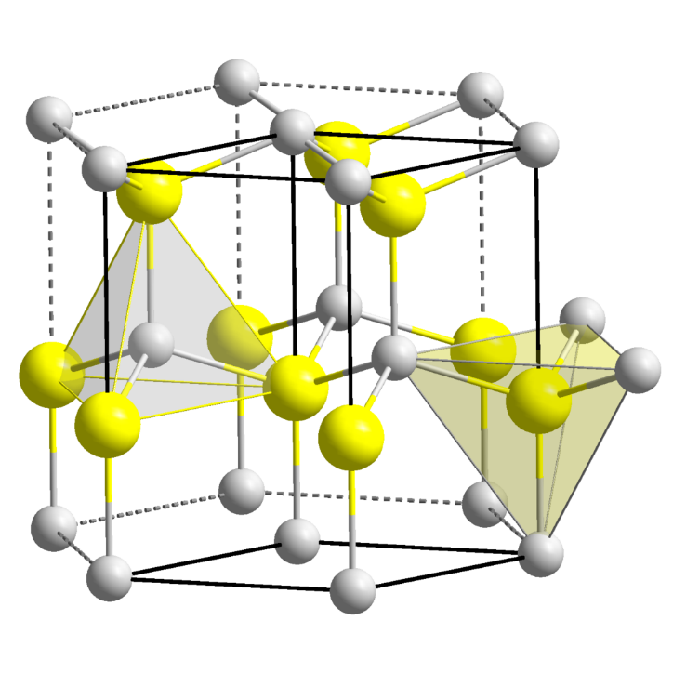
Setting the Stage
“Chemical Vapor Deposition of Porous Metal-Organic Materials and Metal Oxides“
e.g.
Mg-O
Al-O
Zn-O
hexagonal wurtzite crystal structure
wide direct band gap (3.3 eV)
piezo-electric
transparent
Introducing porosity:
increased surface area
*
* https://de.wikipedia.org/wiki/Zinkoxid

Slide 3
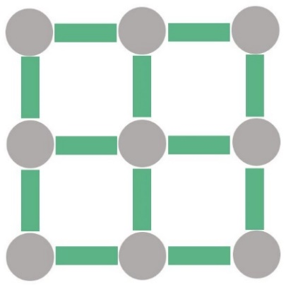
Setting the Stage
“Chemical Vapor Deposition of Porous Metal-Organic Materials and Metal Oxides“
metal node
metal-organic framework:
+
=
organic linker
MOF
highly porous structure
→ Surface areas of several thousand m² /cm³
vast library of linker and node materials
→ over 90,000 MOFs synthesized so far
Cambridge Crystallographic Data Centre
https://www.ccdc.cam.ac.uk

Slide 4
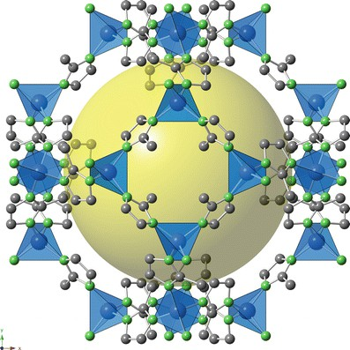
Setting the Stage
“Chemical Vapor Deposition of Porous Metal-Organic Materials and Metal Oxides“
robust porosity
good resistance to thermal changes
high chemical stability
*
ZIF-8
Zn(mIM)₂
C₆H₆N₄Zn
* Hara N. (2016) ZIF-8 Membrane. In: Drioli E., Giorno L. (eds)
Encyclopedia of Membranes. Springer, Berlin, Heidelberg

Slide 5
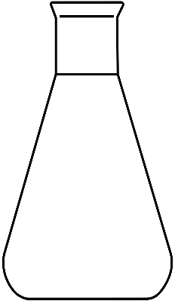
Setting the Stage
“Chemical Vapor Deposition of Porous Metal-Organic Materials and Metal Oxides“
catalysis
electronic sensing
solution based methods
drug delivery
energy
harvesting
storage
&
release
photonic
crystals
Chemical vapor deposition enables:
deposition on large areas
up-scaling
device integration

Slide 6
Setting the Stage
“Chemical Vapor Deposition of Porous Metal-Organic Materials and Metal Oxides“
reaction chamber
reactant gases
by-products
CVD is a family of techniques:
Initiated chemical vapor deposition (iCVD)
Atomic layer deposition (ALD)
Molecular layer deposition (MLD)

Slide 7

Two Stories
1) Oriented ZIF-8
linker vapour
ALD
ZnO
ZIF-8
Si
Si
Si
2) Porous ZnO
MLD
zincone
porous ZnO
Si
Si
Si

Slide 8
Story 1: Oriented ZIF-8
linker vapour
ALD
ZnO
ZIF-8
Si
Si
Si

Slide 9
Synthesis: ZnO
plasma enhanced atomic layer deposition (PE-ALD)
Si
diethylzinc
ALD
ZnO
Si
HmIM vapour
purge
purge
ZIF-8
Si
co-reactant: oxygen plasma
I. Stassen, et al.; N. Mater. 15, 304-310 , 2016

Slide 10
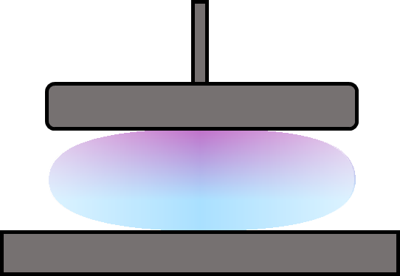
Synthesis: ZnO
Depositing ZnO with different densities:
Si
top electrode
ALD
ZnO
Si
HmIM vapour
ground electrode
ZIF-8
Si
distance between electrodes:
5 cm (with stage)
7 cm (without stage)

Slide 11
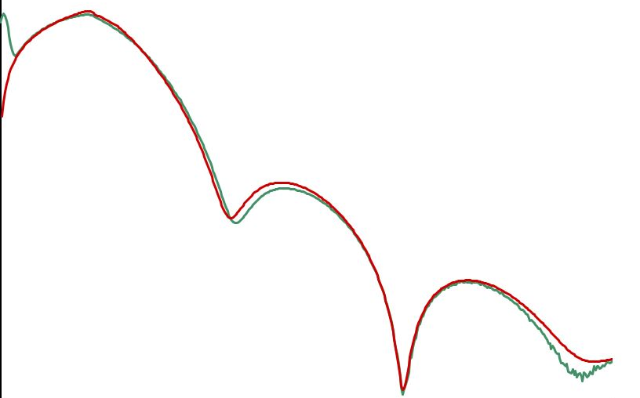
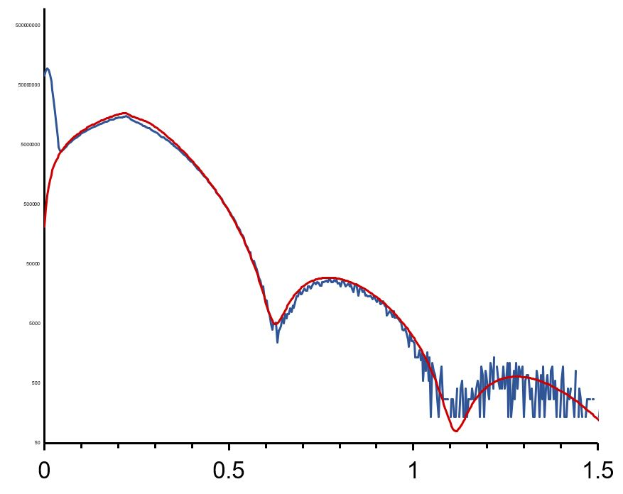
Synthesis: ZnO
Depositing ZnO with different densities:
Si
ALD
ZnO
less dense ZnO
ρ = 4.6 g/cm³
Si
intensity [a.u]
HmIM vapour
ZIF-8
denser ZnO
ρ = 5.2 g/cm³
Si
0 0.5 1 1.5
theta [°]

Slide 12
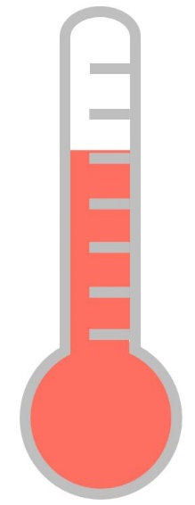
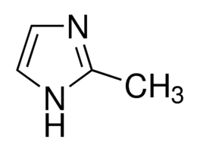
Synthesis: From ZnO to ZIF-8
Si
120°C
ALD
ZnO
2-methylimidazole (HmIM)
Si
ZnO
HmIM vapour
ZIF-8
Si
ZIF-8
ZnO + 2 HmIM
H₂O + ZIF-8
Si
I. Stassen, et al.; N. Mater. 15, 304-310 , 2016

Slide 13



Synthesis: Parameters
Si
Influence of deposition parameters on ZIF-8?
ALD
ZnO
ρ
Si
HmIM vapour
ZIF-8
Si

Slide 14
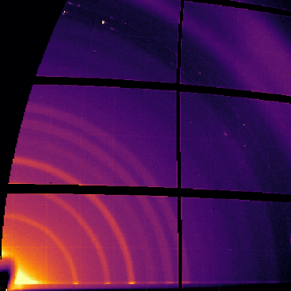
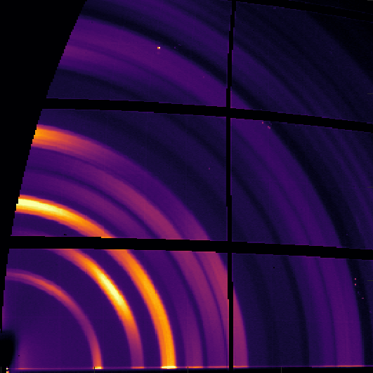
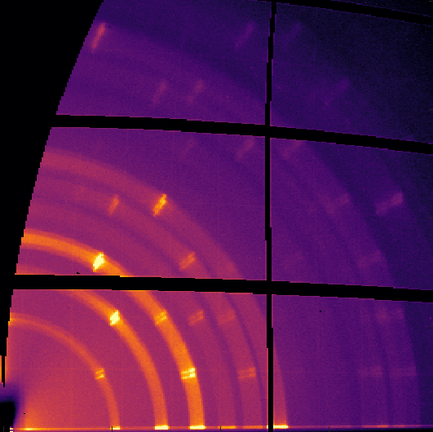
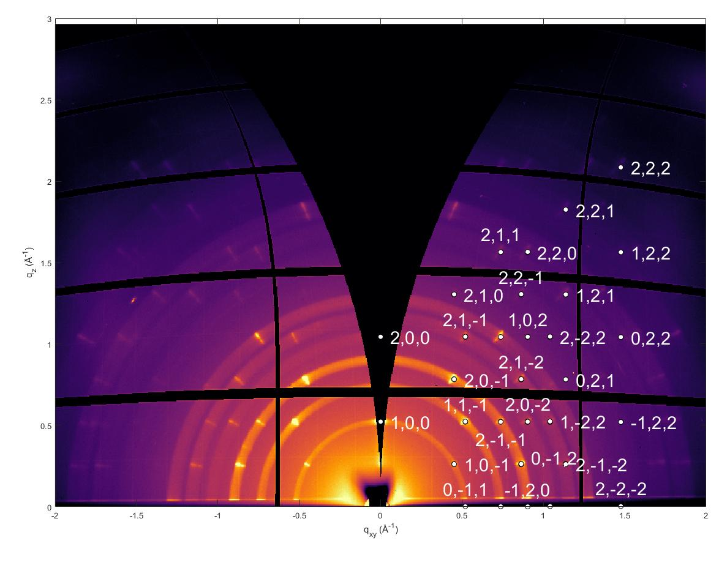
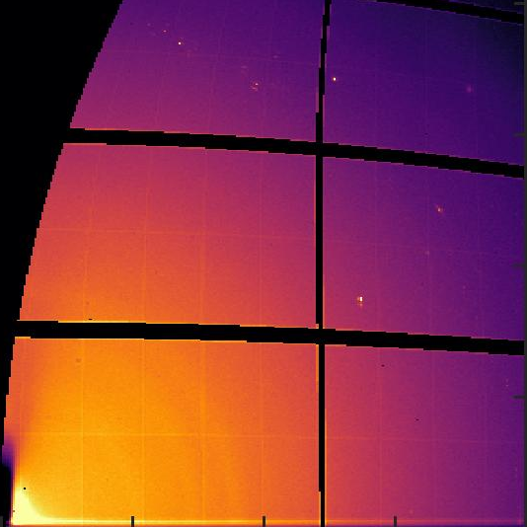
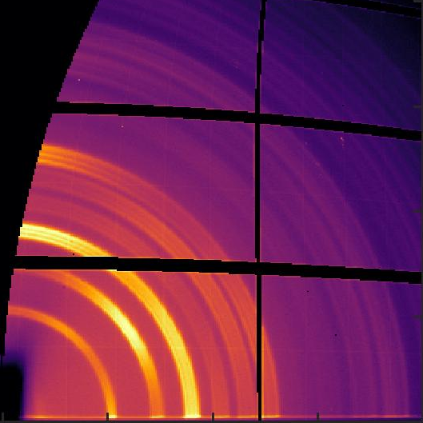
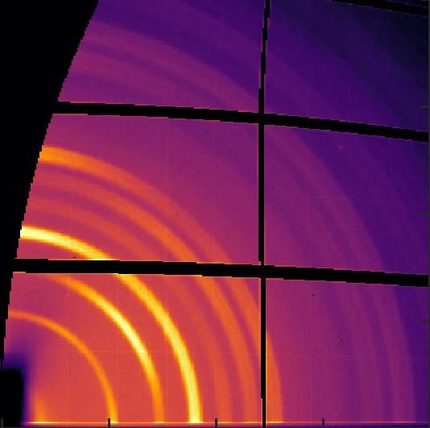
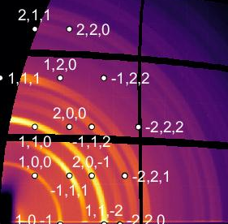
ZIF-8: Crystallographic Orientation
Crystallographic orientation of ZIF-8 can be tuned via ZnO thickness and density.
10 nm, 20 min
10 nm, 24 h
3 nm, 24 h
2
1
0
q_{z} [Å⁻¹]
(100) pref. orientation
mosaicity (1.8 ± 0.3)°
ZIF-8
(less dense ZnO)
2
1
0
q_{z} [Å⁻¹]
ZIF-8
(denser ZnO)
(111) pref. orientation
mosaicity (30 ± 2)°
0 1 2
0 1 2
0 1 2
q_{xy} [Å⁻¹]
q_{xy} [Å⁻¹]
q_{xy} [Å⁻¹]

Slide 15
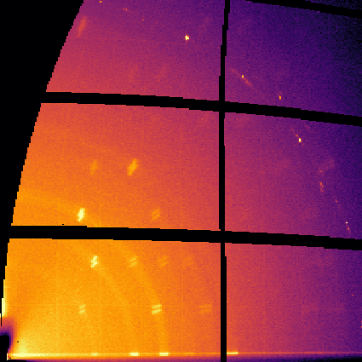
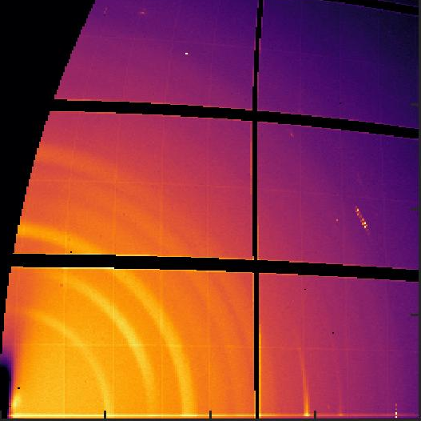
ZIF-8: Crystallographic Orientation
Crystallographic orientation of ZIF-8 can be tuned via ZnO thickness and density.
10 nm, 24 h
3 nm, 24 h
1 nm, 24 h
2
1
0
q_{z} [Å⁻¹]
ZIF-8
(less dense ZnO)
2
1
0
q_{z} [Å⁻¹]
ZIF-8
(denser ZnO)
0 1 2
0 1 2
0 1 2
q_{xy} [Å⁻¹]
q_{xy} [Å⁻¹]
q_{xy} [Å⁻¹]

Slide 16
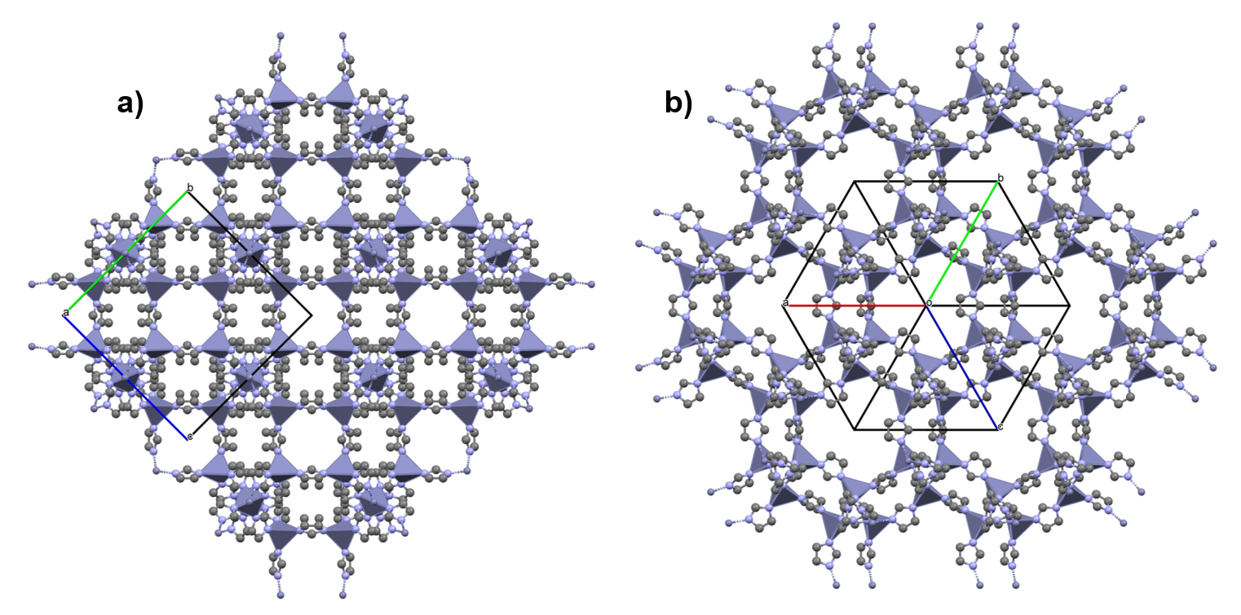
ZIF-8: Crystallographic Orientation
(100) preferred orientation
(111) preferred orientation

Slide 17
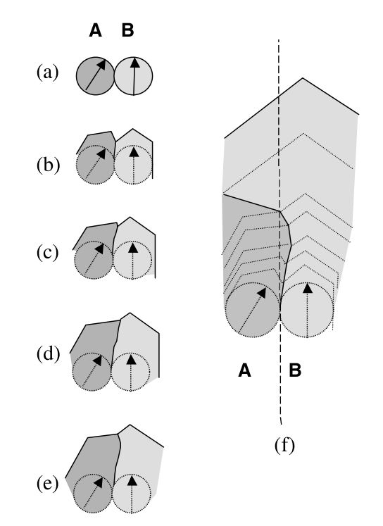
ZIF-8: Crystallographic Orientation
(111) preferred orientation: kinetically hindered growth
“Modified competitive growth model”
(100)
Crystals with fastest growth direction at a tilt overtake crystals with normal growth.
Crystals with fastest growth perpendicular to the membrane dominate.
Bons, Bons. Microrporous and Mesoporous Materials 2003, 62, 9-16
Notes:
Mention: (100) is fastest growing direction!

Slide 18
ZIF-8: Crystallographic Orientation
Hypothesis for (100) preferred orientation:
Ultra-thin ZnO layers → easier linker access
Less dense ZnO → higher defect rate
ZnO
ZIF-8
Si
Si
Si
HmIM vapour
HmIM vapour
A. Cruz, et al. Dalton Trans., 2021, 50, 6784–6788

Slide 19
Story 1: Conclusion
We can synthesize oriented ZIF-8 via vapor deposition!
We can tune preferred orientation via ZnO thickness and density!
More information in our latest publication.
ZIF-8
(less dense ZnO)
ZIF-8
(denser ZnO)
3 nm ZnO, 24 h conversion
M. Kräuter, et al.; Crystals 2022, 12(2), 217

Slide 20
Story 2: Porous ZnO
MLD
zincone
porous ZnO
Si
Si
Si

Slide 21
Synthesis: Zincone
Molecular Layer Deposition
Si
diethylzinc
MLD
zincone
Si
purge
purge
porous ZnO
Si
ethylene glycol
substrate temperature: 110 °C - 125 °C

Slide 22
Synthesis: from Zincone to ZnO
derived from
diethylzinc
ethylene
glycol
Si
MLD
zincone
Si
calcination
340 °C
400 °C
500 °C
porous ZnO
Si
porous ZnO

Slide 23
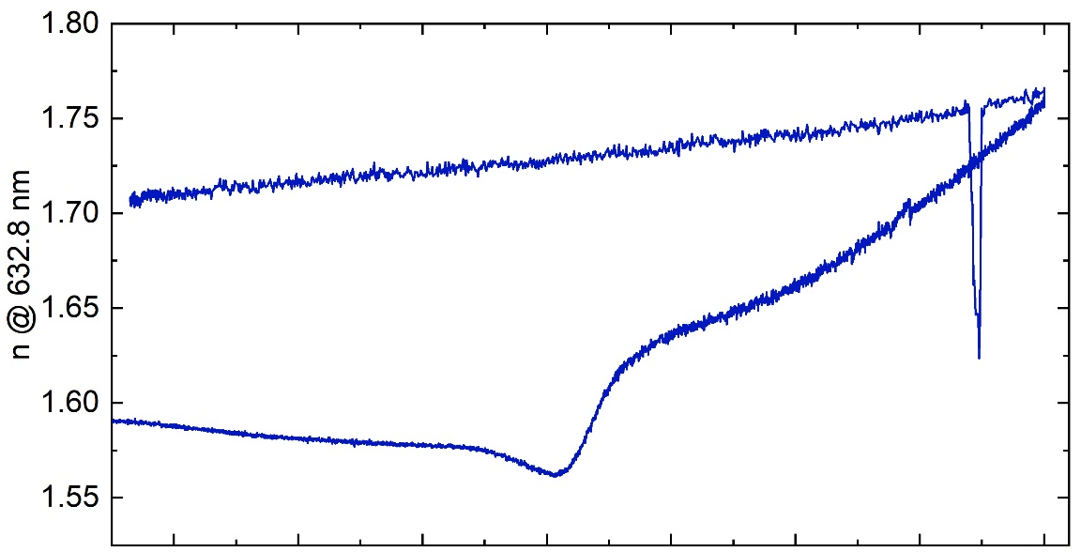
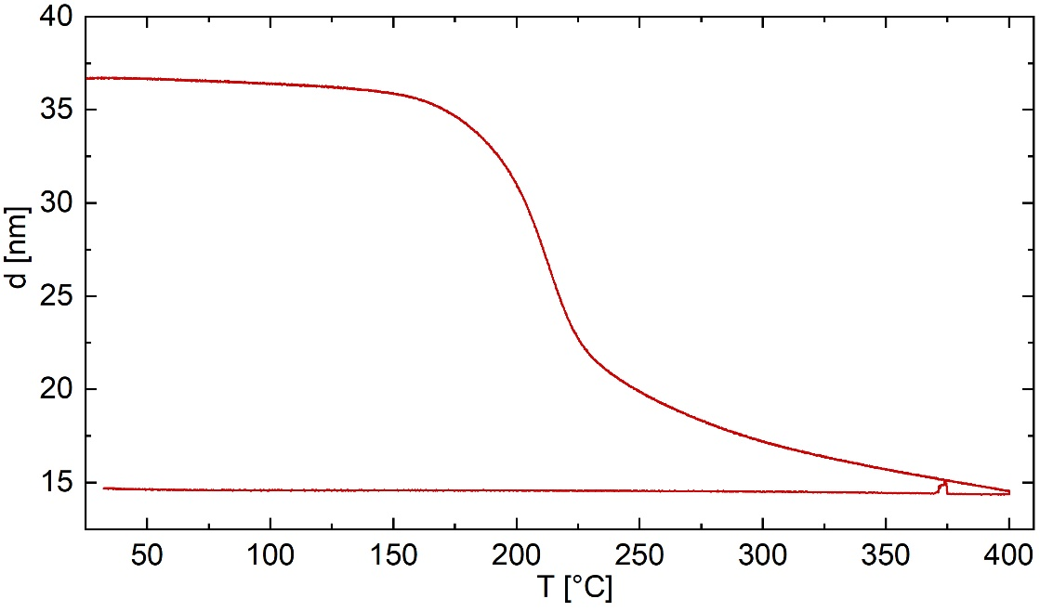
Synthesis: from Zincone to ZnO
MLD @ 110 °C
Si
MLD
zincone
Si
collapse
crystallisation
porous ZnO
Si

Slide 24
ZnO: Porosimetry
Ellipsometric porosimetry:
measuring the volume fraction of open pores of a porous thin film
increase pressure of probing vapor and measure refractive index, n
as pressure increases, probing vapor molecules adsorb in pores
  → n increases
$$\frac{V_{probe}}{V}=\frac{\frac{n^{2}−1}{n^{2}+2} − \frac{n_{0}^{2}−1}{n_{0}^{2}+2}}{\frac{n_{probe}^{2}−1}{n_{probe}^{2}+2}}$$
In situ ellipsometer
calculate volume fraction of condensed liquid inside film via effective media approximation

Slide 25
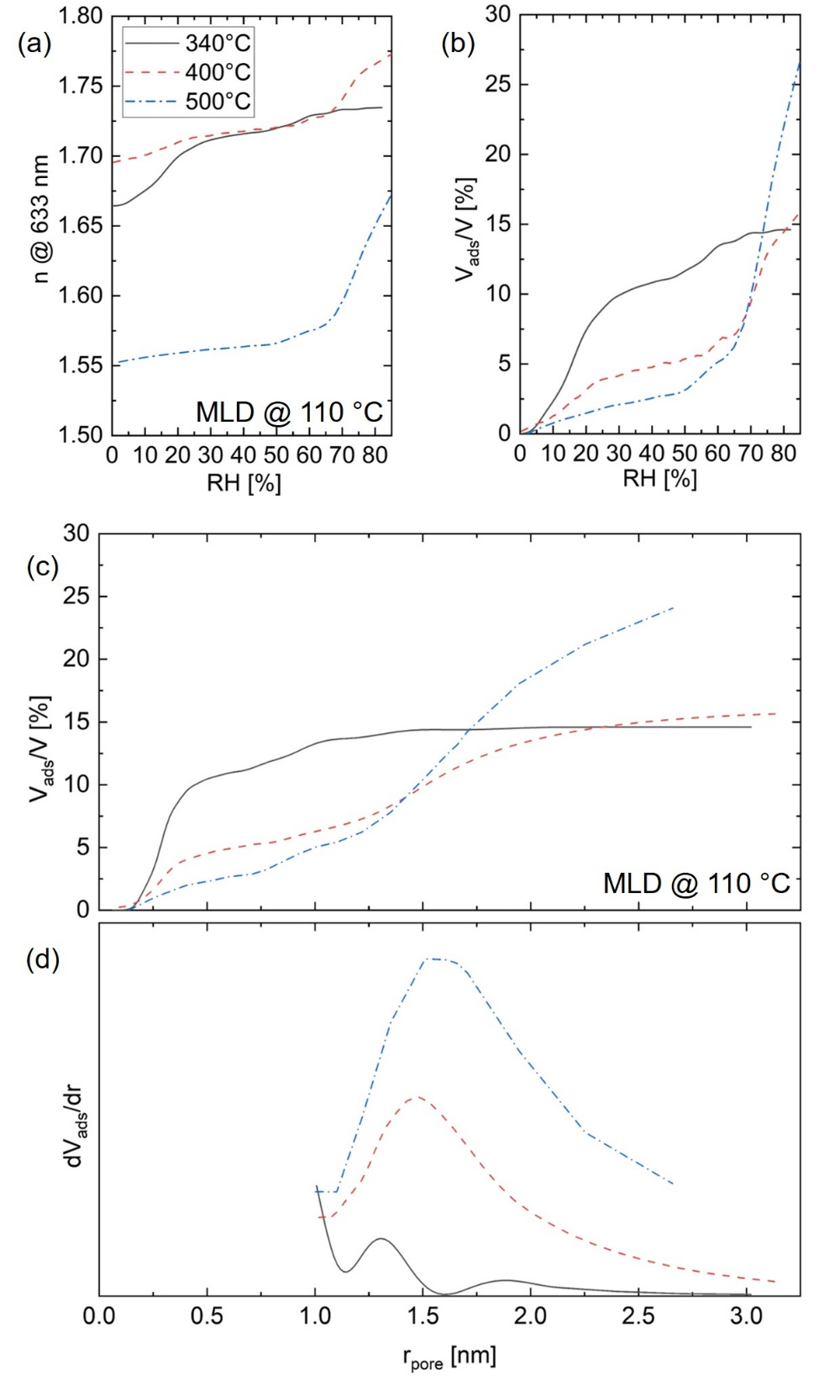
ZnO: Porosimetry
MLD @ 110 °C
$$\frac{V_{probe}}{V}=\frac{\frac{n^{2}−1}{n^{2}+2} − \frac{n_{0}^{2}−1}{n_{0}^{2}+2}}{\frac{n_{probe}^{2}−1}{n_{probe}^{2}+2}}$$
effective media approximation
$$r_{pore}= \frac{γ∗ V_{m}}{R∗T∗\ln\left(\frac{p_{0}}{p}\right)}$$
We want to know porosity as a function of pore size:
Kelvin-eqn. for cylcindrical pores

Slide 26
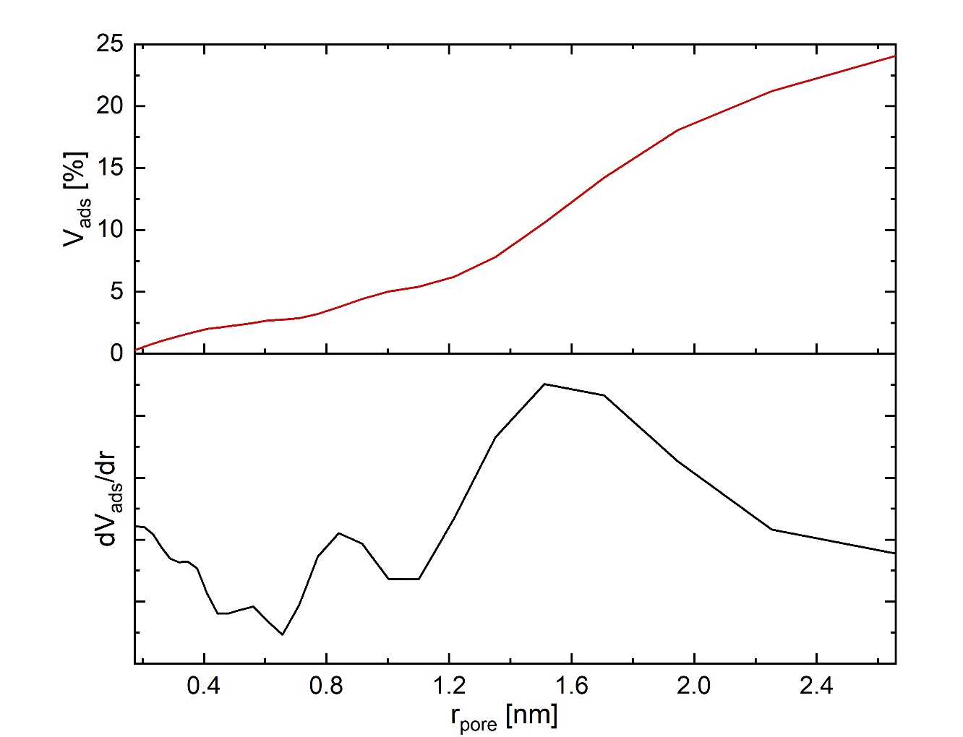
ZnO: Porosimetry
MLD @ 110°C
annealed at 500°C
overall: 24 %
micropores ≈ 5%
mesopores ≈ 19%
mean pore radius: 1.5 nm
→ diameter = 3 nm
microporous
regime
mesoporous
regime
Mean pore radius only for pores > 2 nm

Slide 27
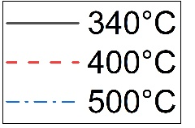
ZnO porosity
MLD @ 110 °C
As annealing temperature increases…
overall porosity increases
microporosity decreases
mesoporosity increases
mean pore radius does not change significantly

Slide 28
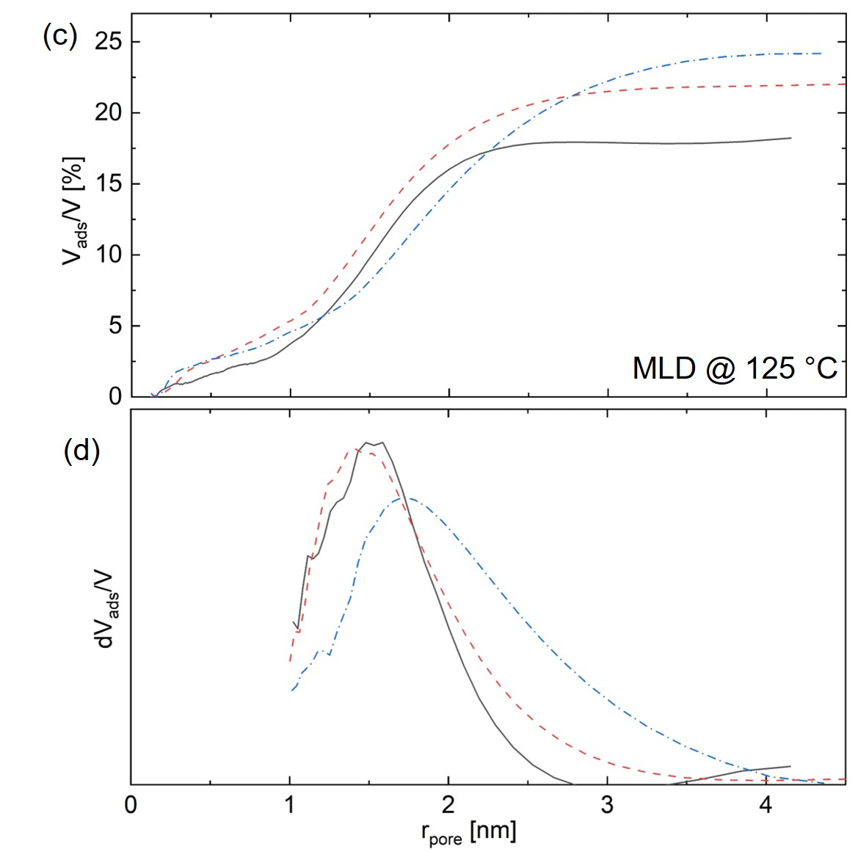
ZnO porosity
MLD @ 110 °C
MLD @ 125°C

Slide 29
ZnO porosity
MLD @ 125°C
Higher MLD deposition temperature leads to…
more porosity for lower annealing temperatures
less micropores
more mesopores
approximately the same mean pore radius

Slide 30

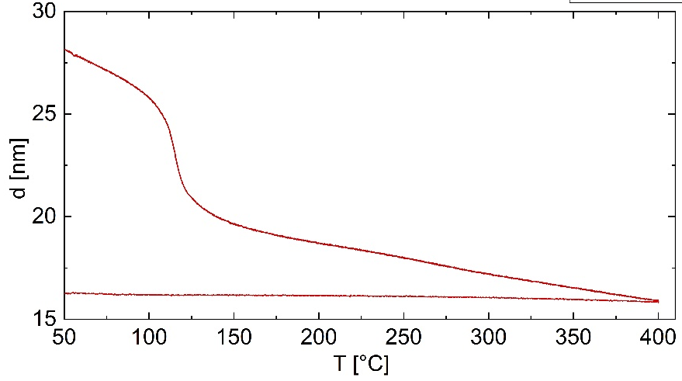
ZnO: Porosimetry
Hypothesis for porosity behaviour due to…
MLD @ 110 °C
…calcination temperature
removal of organic content
crystallization
collapse
crystallisation
MLD @ 125 °C
…MLD deposition temperature
different zincone composition
different behavior during calcination
MLD @ low T
MLD @ high T
B. Yoon., et al.; Chem. Vap. Deposition 2009, 15, 112–121

Slide 31
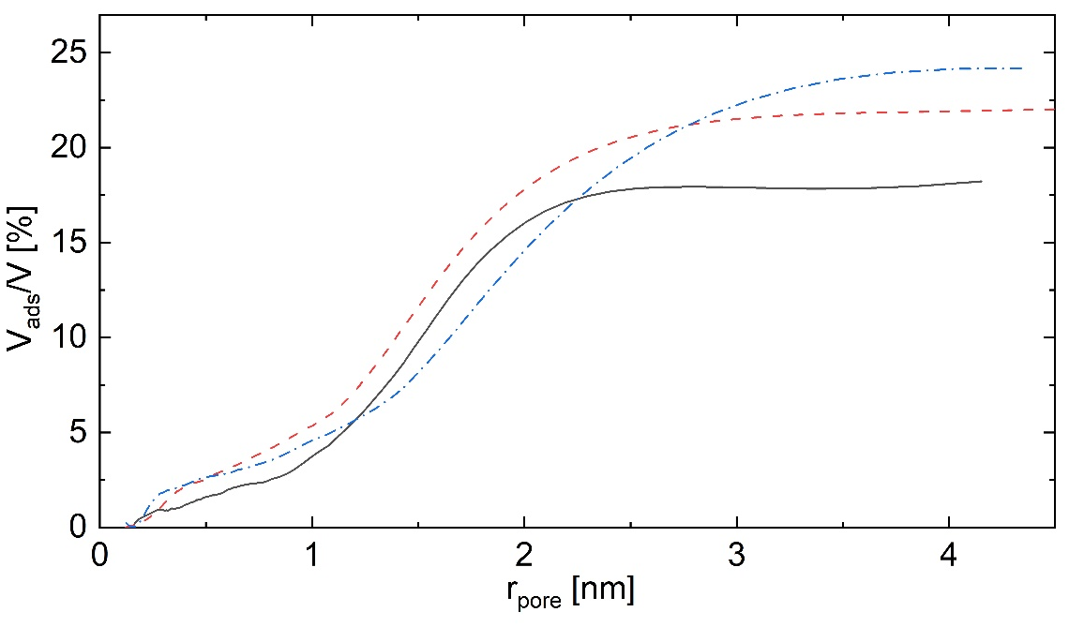
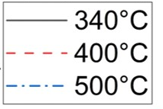
Story 2: Conclusion
Porosity of ZnO can be tuned via calcination temperature.
MLD deposition temperature also influences the porosity.
Open porosity of up to 24% could be achieved.
MLD @ 125°C

Slide 32
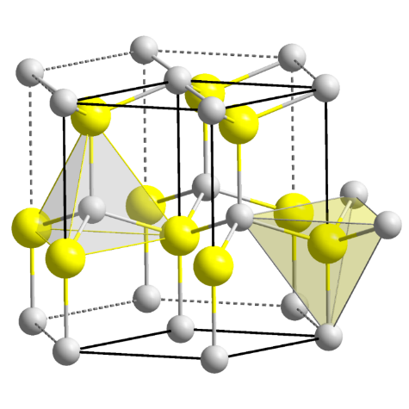
Take-Home Message
High surface area of porous materials leads to new possibilities.
Chemical vapor deposition well suited to deposit porous materials.
Still a lot of room left to explore properties and applications.
ZnO
ZIF-8
chemical vapor deposition

Slide 33
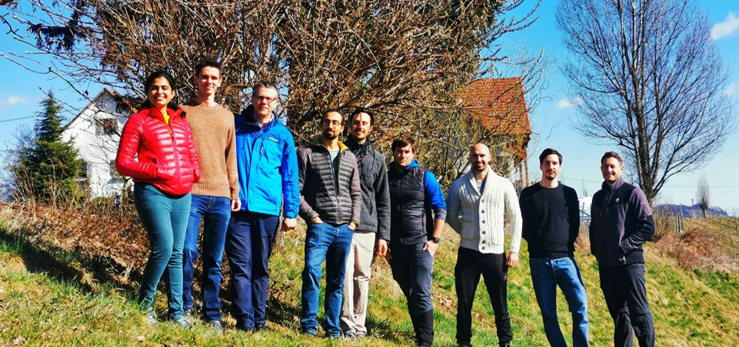
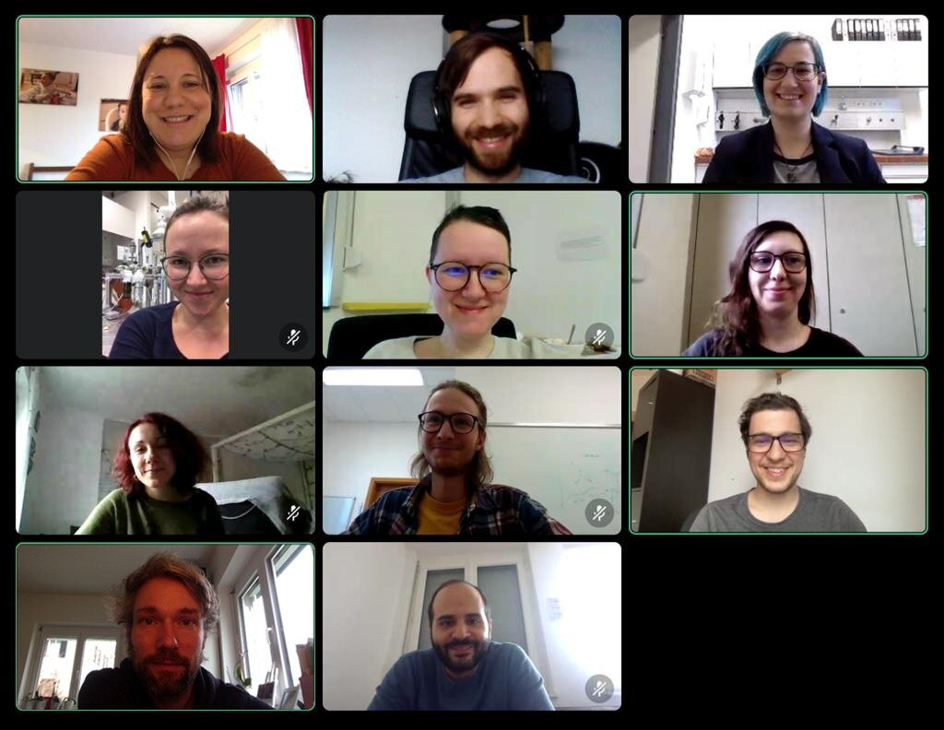

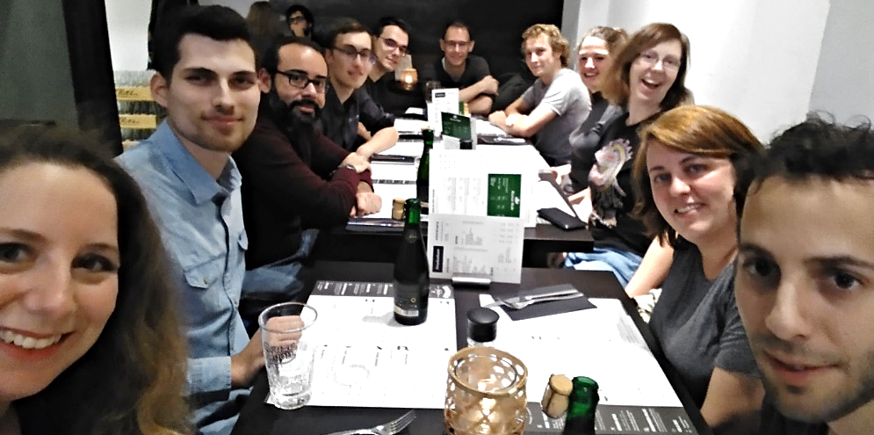

Thank You!
Prof. Roland Resel & group
if.tugraz/users/resel
amelootgroup.org
Prof. Rob Ameloot & group
Prof. Anna Maria Coclite & group
annacoclite.com
LEAD project
www.tugraz.at/projekte/pmw

Slide 34
Thank you for your
attention!
Marianne Kräuter
marianne.kraeuter@tugraz.at

