Slide 1
PowerPoint Presentation
Do's and Don'ts

Slide 2
General Guidelines for Presentations (1)
The given presentation time is mandatory
  Exceeding the time limit is not allowed
  Rule of thumb: One slide per minute
Speak freely
  Don’t read aloud from the slides or notes
  Look straight into the auditorium
Final discussion
  Switch to the corresponding slide
    by entering the slide number → Enter (e.g. 5 + Enter)

Slide 3
General Guidelines for Presentations (2)
Bring the presentation on a USB stick with you
  Format *.ppt or *.pptx (Microsoft PowerPoint-presentation)
  As a backup, bring the presentation additionally as *.pdf
Name the documents correctly
  "Presentation Type - Title of Work - Surname"
    Midway Presentation – Relaxation factor of PV heated pools – Lagler
    Final Presentation – Moon influence on controllability of PHIL systems – Galler

Slide 4
General Guidelines for Presentations (3)
Discuss your presentation with your supervisor(s)
  If necessary, limit the area with your supervisor
  Get feedback from your supervisor before the presentation
Use the IEAN template
  Available on TeachCenter
  Adjust the Slide Master
Font and font size
  Recommended Font: Arial
  Use at least a font size of 18 pt

Slide 5
General Guidelines for Presentations (4)
Structure your presentation clearly
  Start with a short overview
  Content
    What was done?
    How was it done?
    Why was it done?
  Outlook
    Addressing open points
  Summary & Conclusion

Slide 6
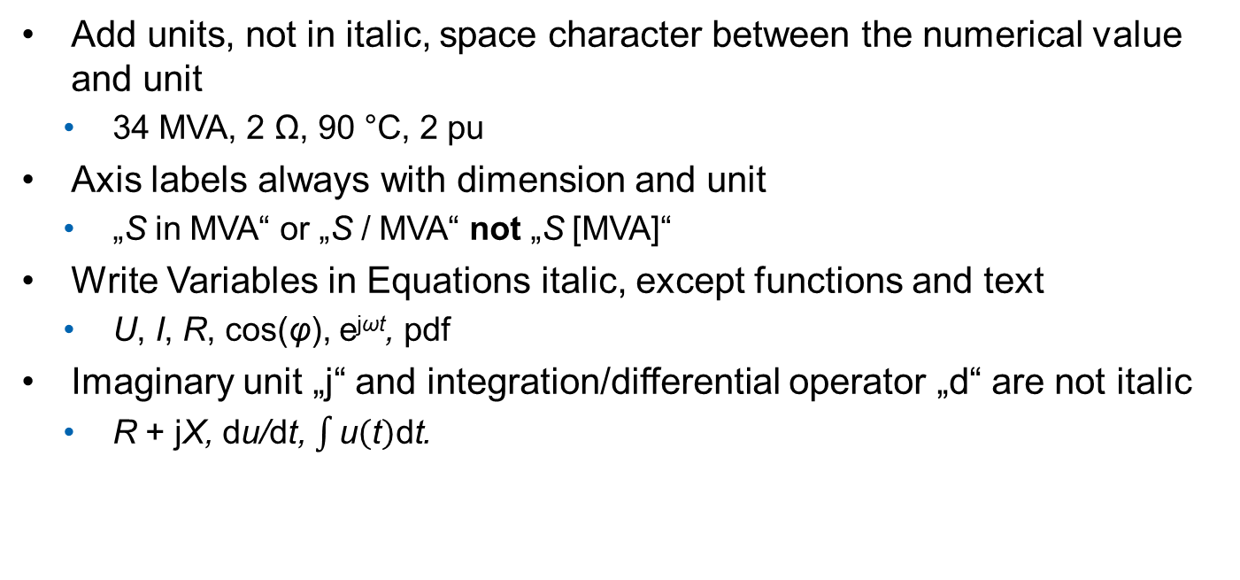
General – Equations and Symbols (1)
Add units, not in italic, space character between the numerical value and unit
  34 MVA, 2 Ω, 90 °C, 2 pu
Axis labels always with dimension and unit
  „S in MVA“ or „S / MVA“ not „S [MVA]“
Write Variables in Equations italic, except functions and text
  U, I, R, cos(φ), e^{jωt}, pdf
Imaginary unit „j“ and integration/differential operator „d“ are not italic
  R + jX, du/dt, $\int{\text{u}\left(\text{t}\right)\text{d}\text{t}}$.

Slide 7
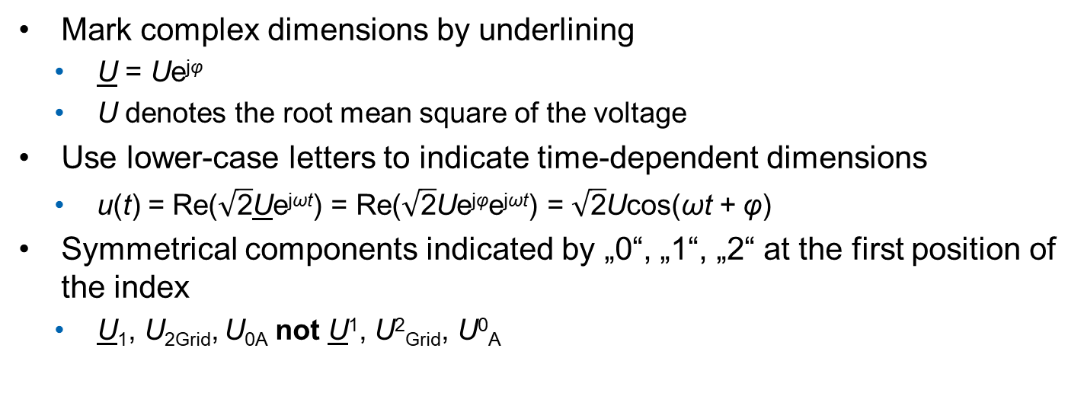
General – Equations and Symbols (2)
Mark complex dimensions by underlining
  U = Ue^{jφ}
  U denotes the root mean square of the voltage
Use lower-case letters to indicate time-dependent dimensions
  u(t) = Re($\sqrt{\text{2}}$Ue^{jωt}) = Re($\sqrt{\text{2}}$Ue^{jφ}e^{jωt}) = $\sqrt{\text{2}}$Ucos(ωt + φ)
Symmetrical components indicated by „0“, „1“, „2“ at the first position of the index
  U₁, U_{2Grid}, U_{0A} not U¹, U²_{Grid}, U⁰_{A}

Slide 8
General – Equations and Symbols (3)
Mark matrices as straight and bold capital letters
  A, T_{S}
Mark vectors as straight and bold lowercase letters
  x, u
The apostrophe „′“ can be inserted with <ALT> + 8242
  R′, x_{d}′′
The dash „–“ can be inserted with <ALT> + 0150

Slide 9
General – Animations
Animations should be used mindfully
  „Appear“ and „Fade“ usually are sufficient
Presentation of big objects & images
  Successive appearance of the complete image
Source: IEAN TU Graz
MV/LV-Transformer
LV Switchgear
DC
Measurement-box
E-Car

Slide 10
General – Figures & Sources
Using figures is usually better than text
  Each figure must be explained verbally
  Labeling has to correspond with the presentation language
Origin of Figures
  The source of the figure has to be cited
  No citation for self-created figures needed

Slide 11
General – Graphs
Graphs should not appear before they are needed
  Give the auditorium time to grasp the graphs
Limit graphs to a few significant curves/data
  Explain the graph verbally, including each axis label, waveform etc.
Discuss the points of interest
  Why is this point interesting and how does it occur?
  Describe the context

Slide 12
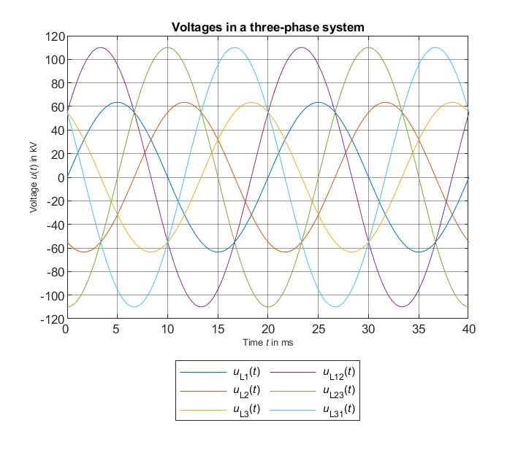
Graphs
Do‘s & Don’ts (1)
Quality of the graphs
  Use vector graphics
  (File formats: .emf, .eps,…)
File format:
.jpeg

Slide 13
Graphs
Do‘s & Don’ts (1)
Quality of the graphs
  Use vector graphics
  (File formats: .emf, .eps,…)
File format:
.emf

Slide 14
Graphs
Do‘s & Don’ts (2)
Graph size
  Plot the graph in the needed
  size!
Font size
  Use a readable font size
Do not simply copy the graphs from
your thesis!

Slide 15
Graphs
Do‘s & Don’ts (3)
Line Specification:
  Line width:
  Matlab (Plot) – LineWidth 2 pt.
  Line style (-, --, .-, :):
  To support a clear visual
  distinction between the
  lines/curves

Slide 16
Graphs
Do‘s & Don’ts (4)
Line colour
  Make a suitable choice for colours!
  Beamers have a different colour
  depth compared to a
  computer screen
  Colours such as yellow are
  difficult to see!

Slide 17
Graphs
Do‘s & Don’ts (5)
Explain the graph in detail
  e.g.: The curve illustrates…
  The horizontal axis represents…
  The solid lines show…
Limit graphs to a few meaningful
curves
  to avoid overstraining the audience
  to cohesively guide the listeners through the graph

