Slide 1
Open Science Day of the Institute of Psychology
Research Data Management
Sarah Stryeck (sarah.Stryeck@tugraz.at)

Slide 2
Agenda
Workshop Research Data Management from 14.00 – 15.00
14.00 – 14.05 Welcome, CoC and Intro
14.05 – 14.20: Open Data vs. FAIR Data, RDM, Data Stewardship, Tools
14.20 – 14.30: CyVerse Demo
14.30 – 14.35: Break
14.35 – 14.55: DMPs, DMPonline
14.55 – 15.00: Questions, Discussion

Slide 3
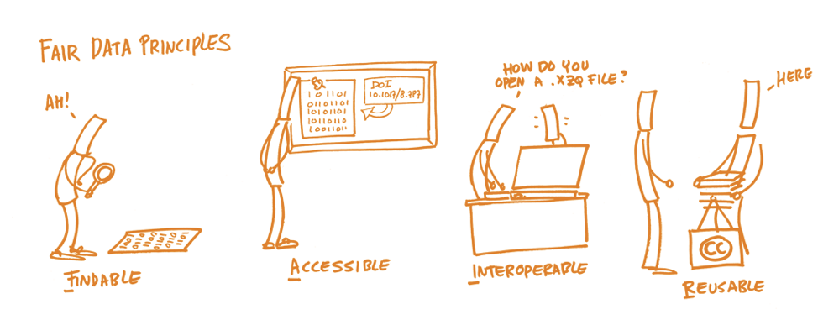
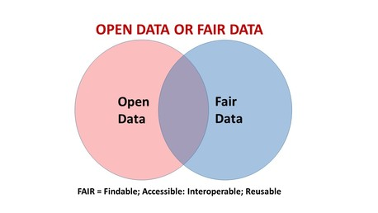
FAIR is not equal to Open!
FAIR only speaks to the need to describe a process – mechanised or manual – for accessing discovered data; a requirement to openly and richly describe the context within which those data were generated, to enable evaluation of its utility; to explicitly define the conditions under which they may be reused; and to provide clear instructions on how they should be cited when reused.
https://www.force11.org/datacitationprinciples

Slide 4
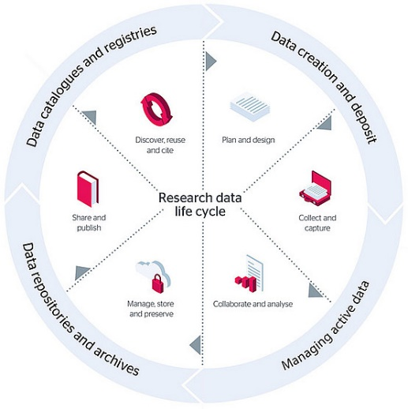
Research Data Management (RDM)
"Research data management concerns the organization of data, from its entry to the research cycle through to the dissemination and archiving of valuable results. It aims to ensure reliable verification of results, and permits new and innovative research built on existing information.“
(from, Whyte, A., Tedds, J. (2011). ‘Making the Case for Research Data Management’. DCC Briefing Papers. Edinburgh: Digital Curation Centre. Available online)

Slide 5
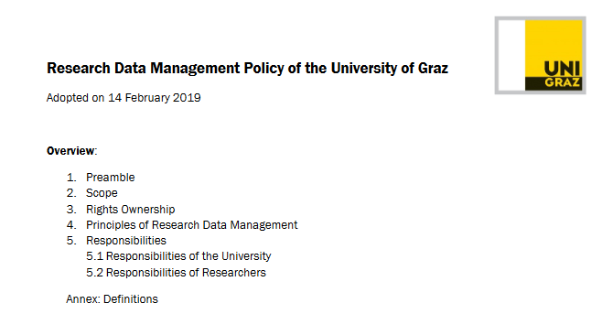
Regulations
Publishers
Funders
Institutional policies

Slide 6
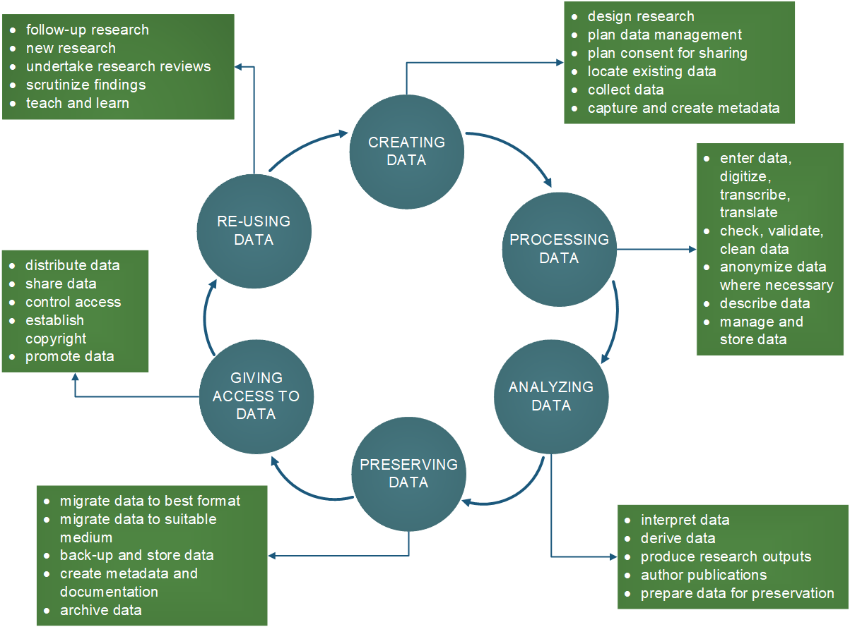
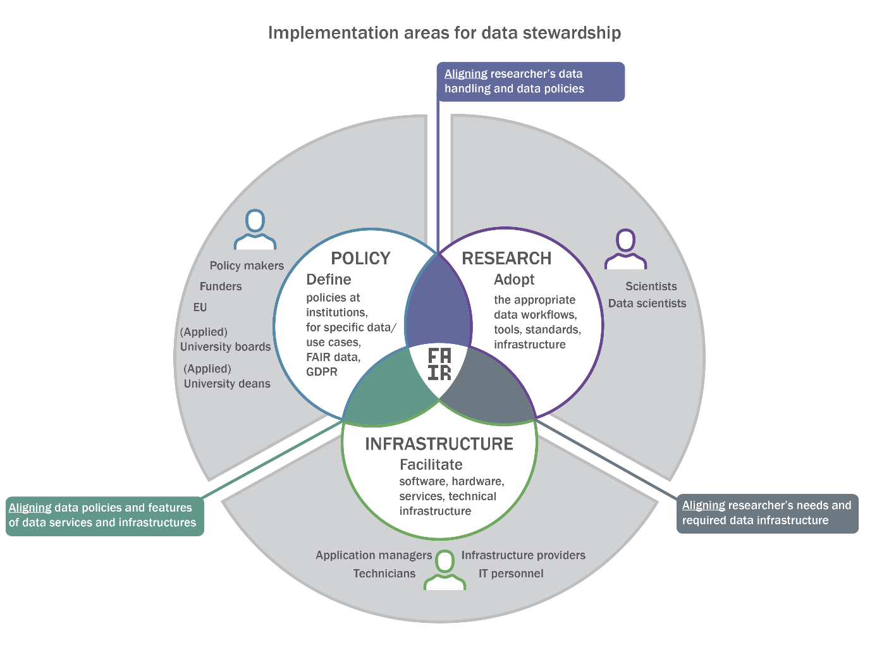
Data Stewardship – Profile and Models

Slide 7
Developments in the Natural Sciences
High-throughput methods
Big Data & new analysis tools
Reproducibility
The challenge is to make data for different stakeholders findable, accessible, interoperable and re-usable.

Slide 8
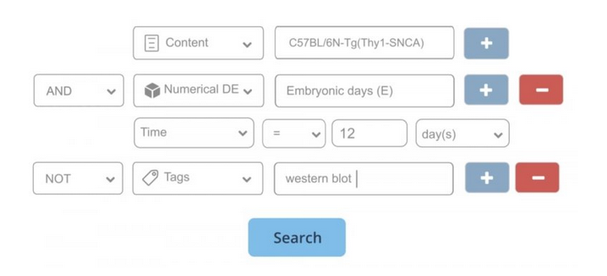
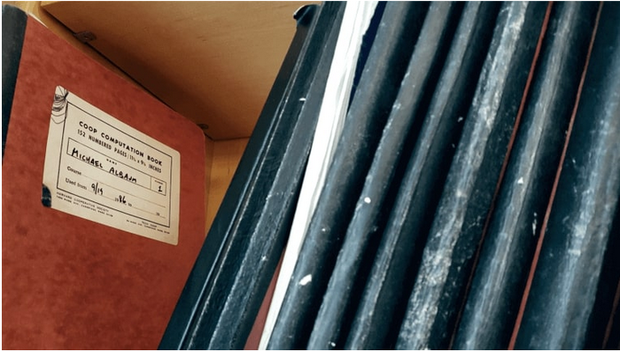
Movement to digital tools – Electronic Labnotebooks
ELNs
Timestamp
Collaboration (teams)
Templates
Backups
Searchable
KFU: Profilbildender Bereich BioHealth

Slide 9
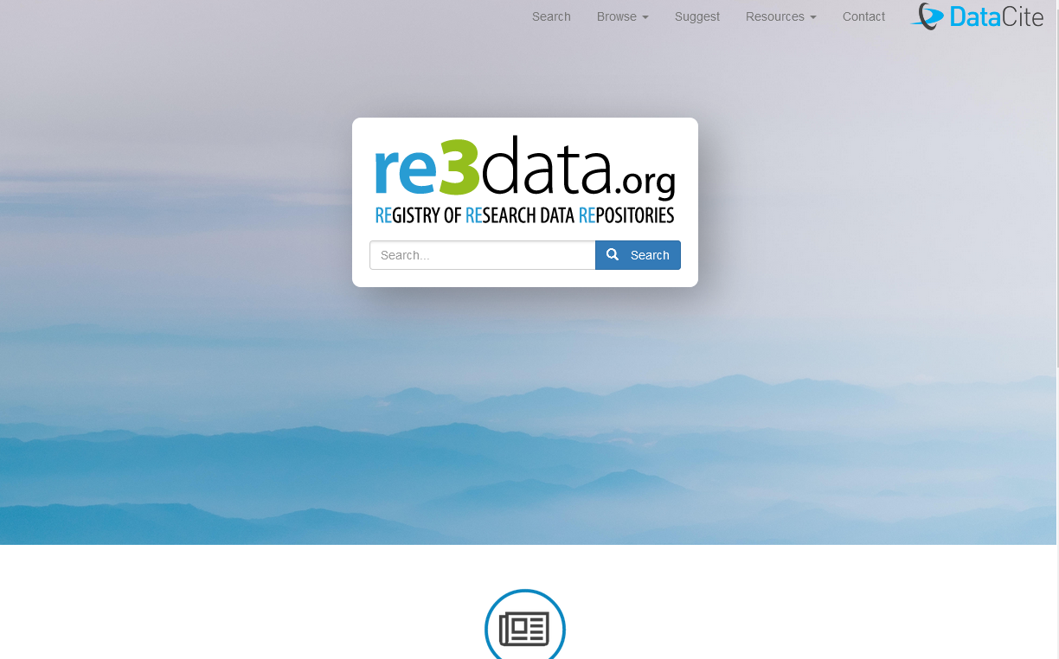
Repositories
Long-term archival of ‘data’ (datasets, presentations, posters, materials, code,…)
Stable identifier (DOI)
Open Science Framework (https://osf.io/)
Zenodo (https://zenodo.org/)
PsychData (https://www.psychdata.de/)
OpenNeuro (https://openneuro.org/)
Looking for a repo? Try https://www.re3data.org/ !

Slide 10
Re-usability of Data: Data Journals
Scientific data (https://www.nature.com/sdata/)
Data in Brief (https://www.journals.elsevier.com/data-in-brief)
Data (https://www.mdpi.com/journal/data)
Data Science Journal (https://datascience.codata.org)
Journal of Open Psychology Data (https://openpsychologydata.metajnl.com/)

Slide 11
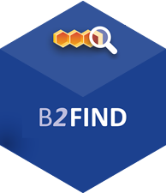
Re-usability: Portals
B2FIND Search (http://b2find.eudat.eu/)
Creative Commons CC Search (https://search.creativecommons.org/)
DataCite Metadata Search (https://search.datacite.org/)
DataONE Datenkatalog (https://search.dataone.org/#data)

Slide 12
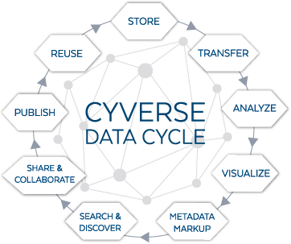
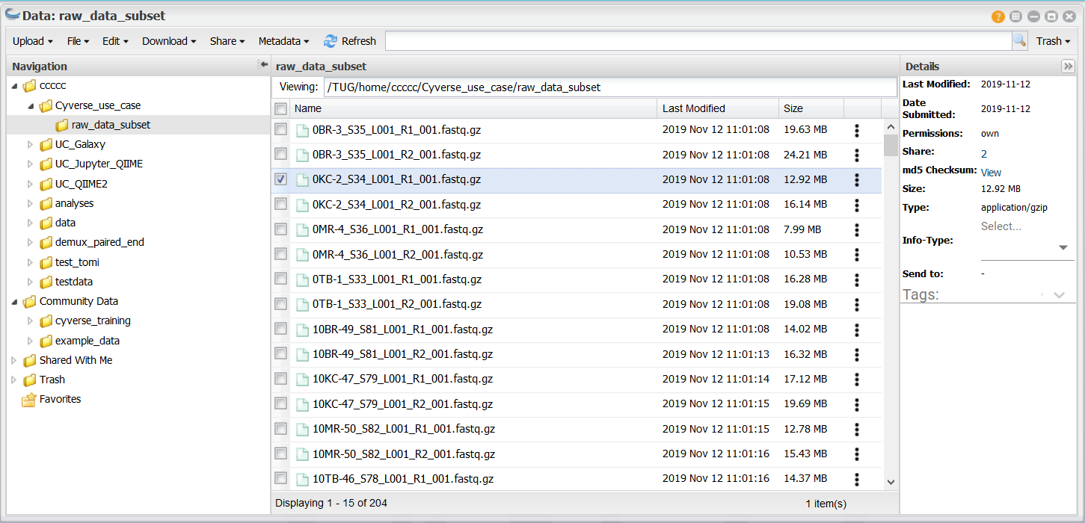
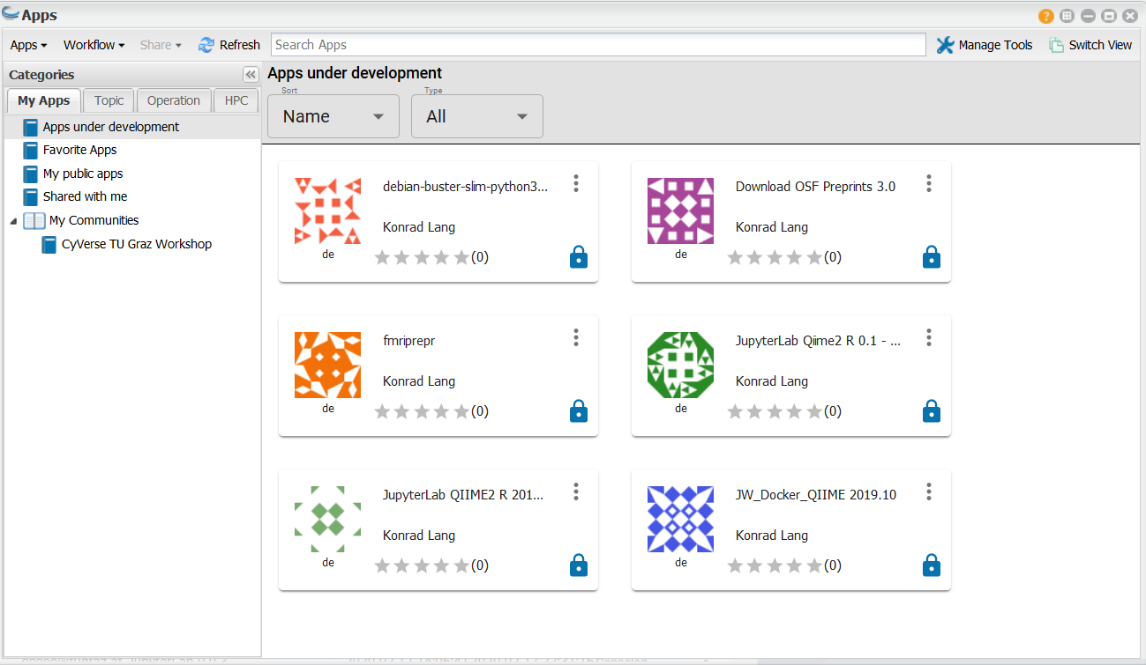
CAT – CyVerse Austria
An easy-to-use RDM tool at the universities in Graz
For data storage and analytics

Slide 13
BREAK

Slide 14
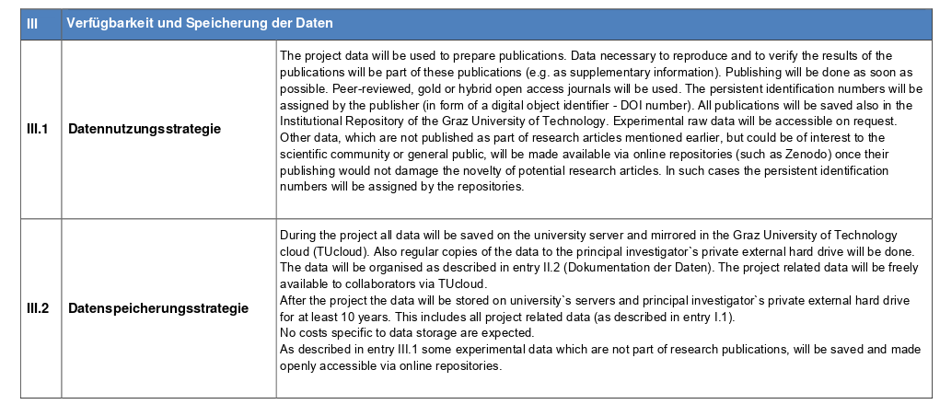
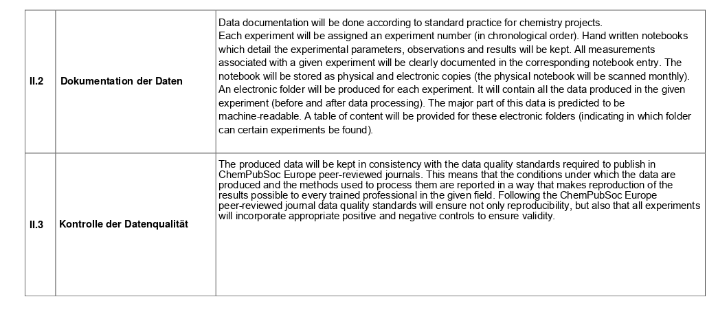
Data Management Plan (DMP)

Slide 15
Creation of a Data Management Plan (DMP)
Why??
Follow the best research practices
Save time for research
Avoid risk of data loss
Ensure transparency and reproducibility
Increase data visibility and number of citations
Fulfill funders’ requirements and receive more grants
Produce new knowledge and make more discoveries just by re-using data
Archive, retrieve and re-use their own data

Slide 16
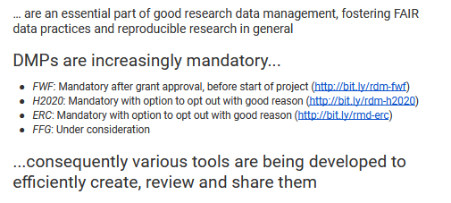
DMP requirements from funders

Slide 17
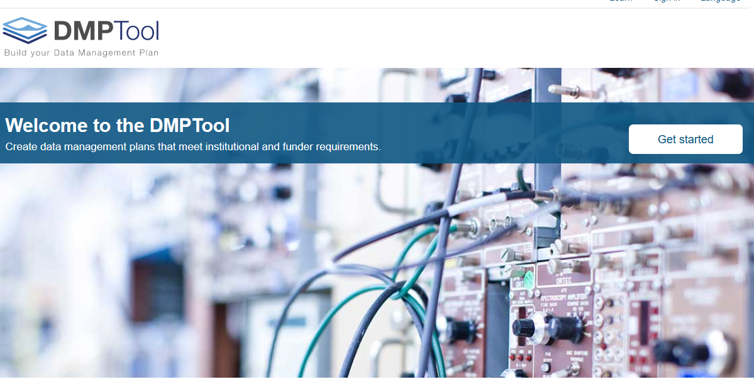
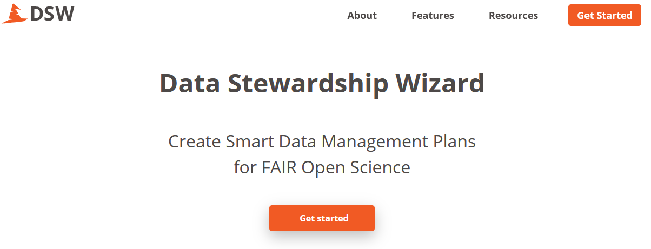
DMP tools
Most cases by filling out a document template or by answering questions from a checklist
Examples include
DMPTool: https://dmp.org
DMPOnline: https://dmponline.dcc.ac.uk/
DS Wizard: https://ds-wizard.org/

Slide 18
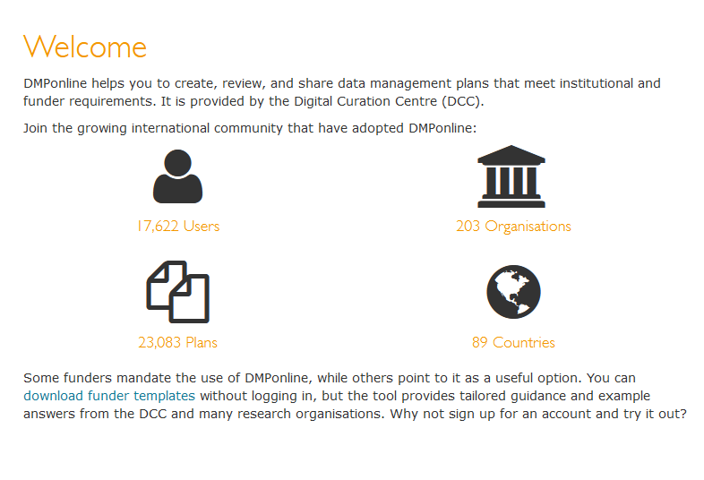
DMPonline

Slide 19
Questions?

Slide 20
Resources
DMPonline: https://dmponline.dcc.ac.uk/
Data Stewardship Wizard: https://ds-wizard.org/
CyVerse: https://www.tugraz.at/sites/cyverse/home/
Scientific data (https://www.nature.com/sdata/)
Data in Brief (https://www.journals.elsevier.com/data-in-brief)
Data (https://www.mdpi.com/journal/data)
Data Science Journal (https://datascience.codata.org) Journal of Open Psychology Data (https://openpsychologydata.metajnl.com/)

Slide 21
Thanks a lot!
Contact
Sarah Stryeck (sarah.stryeck@tugraz.at)

