Slide 1
FAIR Data Austria & RegioData: Integrating research data Infrastructures and services across Institutions
Tony Ross-Hellauer
CyVerse Kick-off Event
30. September 2020
Partners

Slide 2
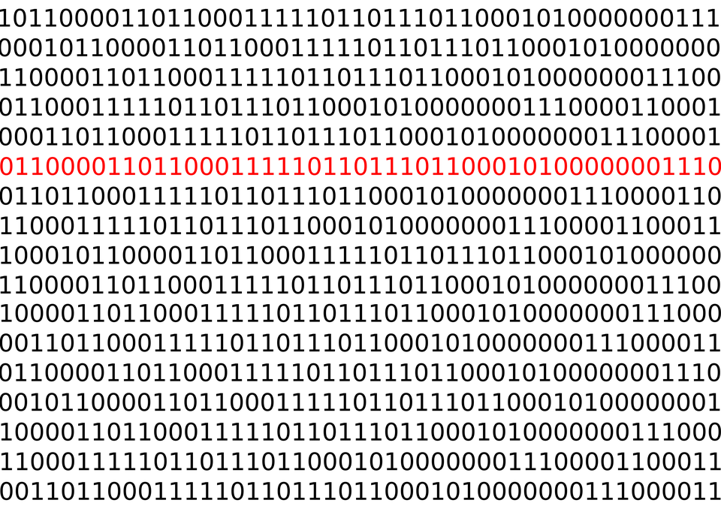
RESEARCH DATA MANAGEMENT
Enable support and services to:
Store, curate, share, analyse data
Ensure reproducibility
Enhance tracking of workflows
Make research outputs re-usable
Collaborate effectively
Train and support researchers
Comply with funder mandates

Slide 3
CC BY 2.5 LIBER / Jorgen Stamp

Slide 4
NOTE: FAIR ≠ Open
Data can be FAIR but not open
Data can be open but not FAIR
FAIR data
Open data
Notes:
FAIR but not open - (E.g., sensitive clinical patient data)
Open but not FAIR - (E.g., badly described, obscure formats, no re-use licenses)

Slide 5
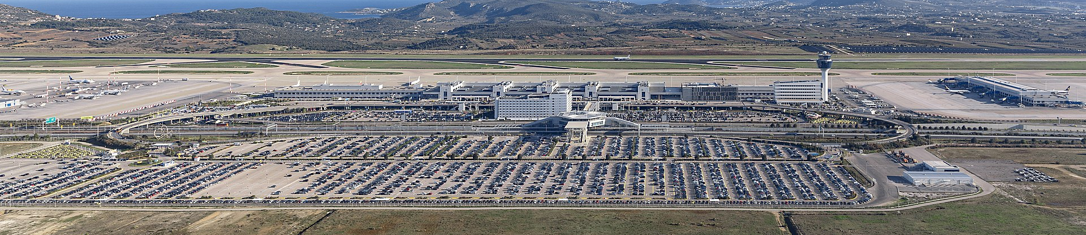
Airlines don’t each build their own airports at each location
They share infrastructure and compete on price, services, etc.
Universities should compete, but not on infrastructure

Slide 6
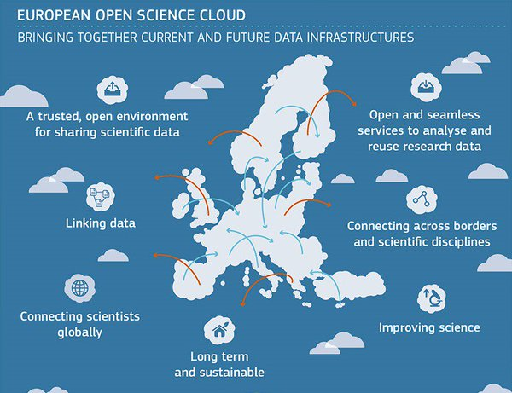
FAIR Data will be the backbone of the European Open Science Cloud (EOSC)
EOSC
EC flagship digital platform for seamless access to data and interoperable services that address the whole research data cycle
From discovery and mining to storage, management, analysis and re-use across borders and scientific disciplines
Institutions, regions and nations need strategies for how to link up to the EOSC

Slide 7






FAIR data Austria
Duration: Jan 2020 – Dec 2022
Budget: 2.7m EUR
Lead:
Partners:
Partners
+ 23 associated partners

Slide 8
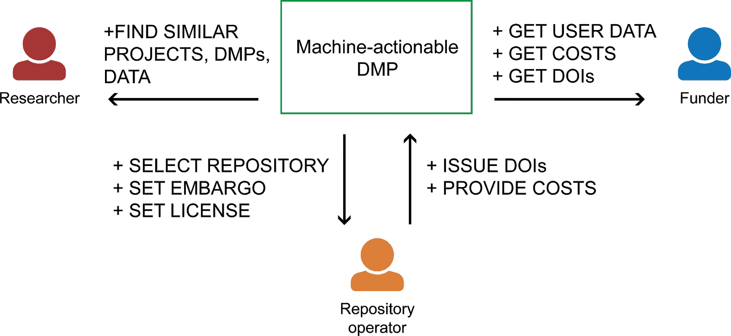
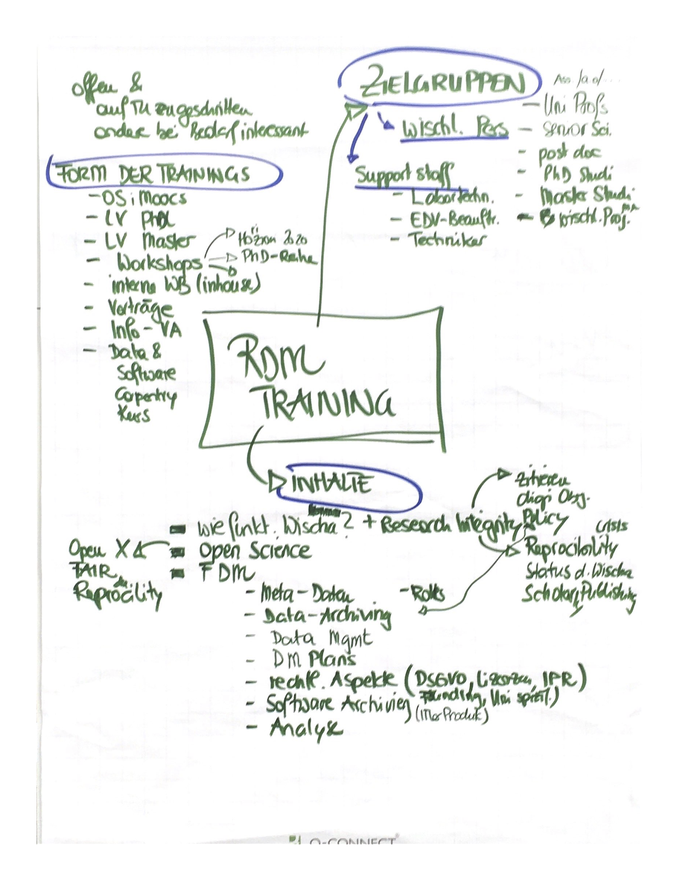
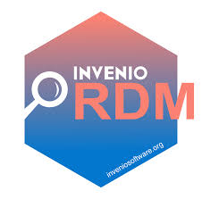
FAIR DATA AUSTRIA
FAIR Data Austria boosts knowledge transfer between universities, the economy and society, and supports the sustainable implementation of the European Open Science Cloud (EOSC) and the FAIR Principles
Impact
For efficient FAIR RDM, it is essential to support the whole research data lifecycle with expert subject knowledge and appropriate tools
The project fosters collaboration between Austrian universities during the development of coherent and sustainable RDM services
Thereby, Austrian universities ensure their competetiveness in the international research landscape

Slide 9
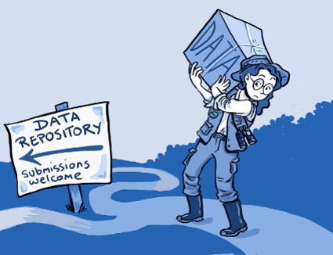
Next-Generation Data Repositories
Development and implementation of advanced repositories for long-term archiving of data, software and databases
InvenioRDM – innovative repository for data and publications – developed by TU Graz in cooperation with CERN
Implementation of InvenioRDM and other tools at associated partner universities

Slide 10
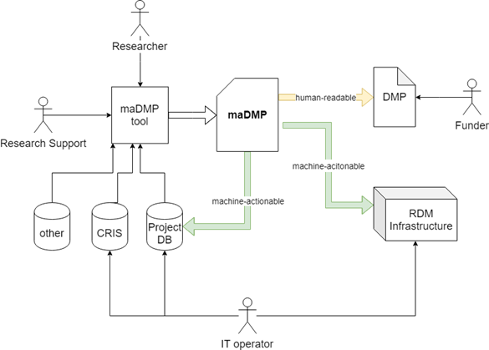
Machine-Actionable data Management plans
Data Management Plans now requirement for most funders
Project will develop and implement a tool for machine-actionable DMPs
Link up to other research systems to ensure „data only once“ and enable easy reporting to funders (FWF)

Slide 11

Development of RDM Processes,
Training & Support
Development of sustainable RDM processes, training and support services at the respective universities
Development of Data Stewardship programmes to support FAIR Data practices
Implementation of a FAIR National Desk
Implementation of local FAIR-Reference-Points as contact points for researchers regarding FAIR practices at the respective institutions

Slide 12

Reference model for collaborative data, information and knowledge management in a regional & European context
RegioData is funded by the Styrian Government (ABT08-24920/2020-14)

Slide 13




RegioData
“... the creation of a collaborative concept for the development of a Styrian reference model of regional data, including the first approach towards a Styrian demonstrator.”
Project coordinator: TU Graz
Partners: TUG, MUG, FHJ, KFU
Start date: 1 September 2020
Duration: 18 months (until February 2022)
Budget: 520,371 €

Slide 14
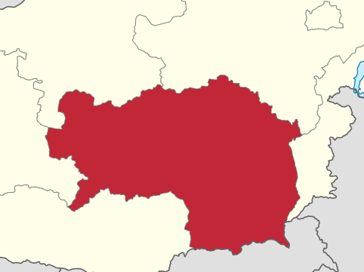
RegioData: Background
Opportunity for integration of data infrastructures and competences at the regional level to enable competetive advantage for research and economic actors
Need for state-of-the-art data infrastructures and services in research and industry
Need for more data science skills amongst Stryian workforce
Need for enhanced policies to enable sharing of data and data infrastructures amongst various stakeholders

Slide 15

RegioData: goals
Goals:
Assess current regional landscape of data infrastructures, skills and policies in research and industry
Compile new use-cases through collaborative dialogue with stakeholders
Create demonstrator projects to show the added-value of integrated data infras
Development of a collaborative concept for the future devlopment of a Styrian RegioData reference model for the collaborative use of big data
Hence, increase EU-wide visibility of Steiermark in data science landscape

Slide 16
RegioData: Activities
Activities clustered in four “thematic pillars”:
  Human resources: Assess education & training opportunities, explore what skills are demanded in the economy & how to match them
  Technical infrastructure: Based on current status & identified gaps, develop Styrian infra (Research Data Management, Storage capacity, Bandwidth, Computing power and Domain-specific analytical tools) to achieve international connectivity and increase technical capability
  Governance: Improve/advance current policies to enable sharing of resources amongst actors; develop model for sustainablity
  Services: Enable value-added services which build on growth of data service and support sector

Slide 17
Thanks!
Contact:
Dr. Tony Ross-Hellauer
Open and Reproducible Research Group
Institute of Interactive Systems and Data Science
TU Graz
Email: tross@know-center.at

