Slide 1
CyVerse Austria Kickoff Event
30.09.2020
Use Case QIIME2
Alexander Mahnert

Slide 2
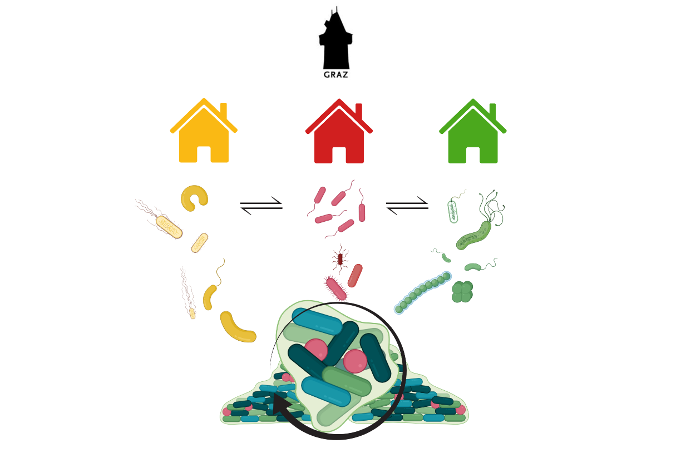
Microbiome research in Graz
benefits:
- collaborations
- more power
- higher impact
challenges:
- many institutions
- many policies
- data security
Created with BioRender.com

Slide 3


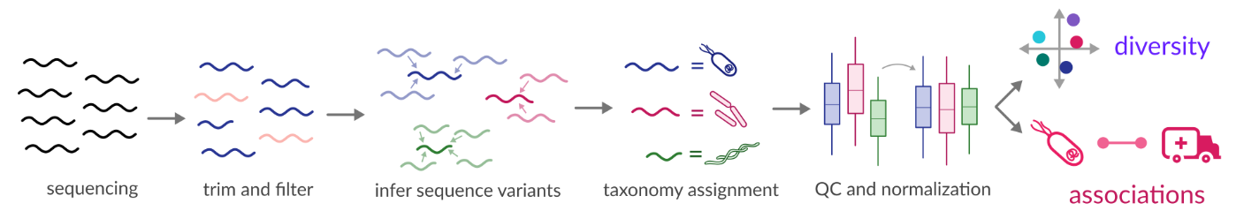
requirements
Secure data storage
Secure data sharing
Comparability
Reproducibility

Slide 4
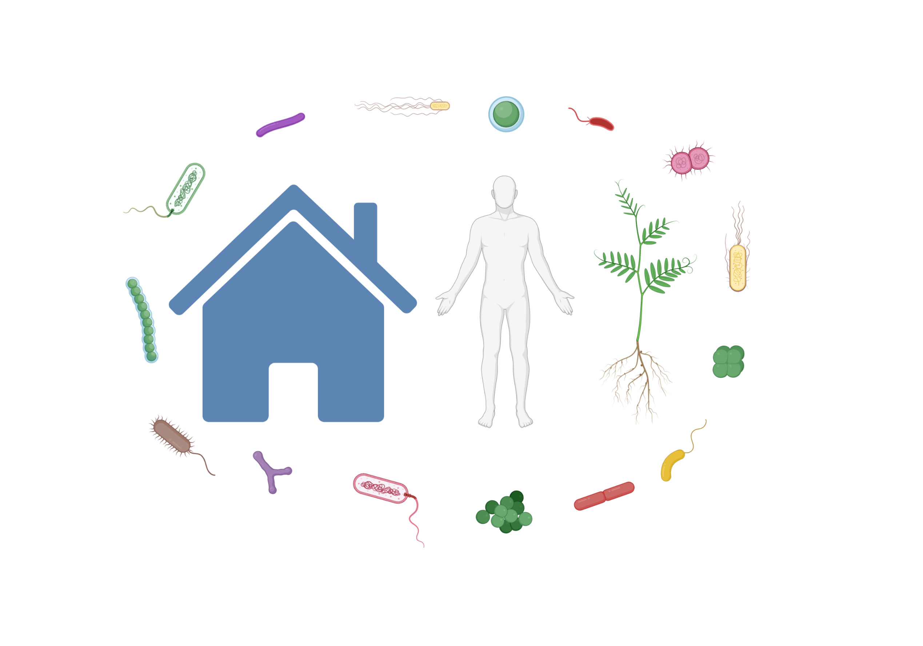
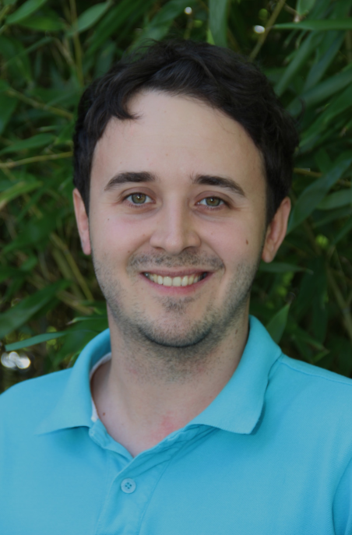


our use case
compare two different data sets in a meaningful way
from two different institutions (MUG, TUG)
process the data according to „FAIR“ principle
Analysis should be based on Qiime2
Created with BioRender.com

Slide 5
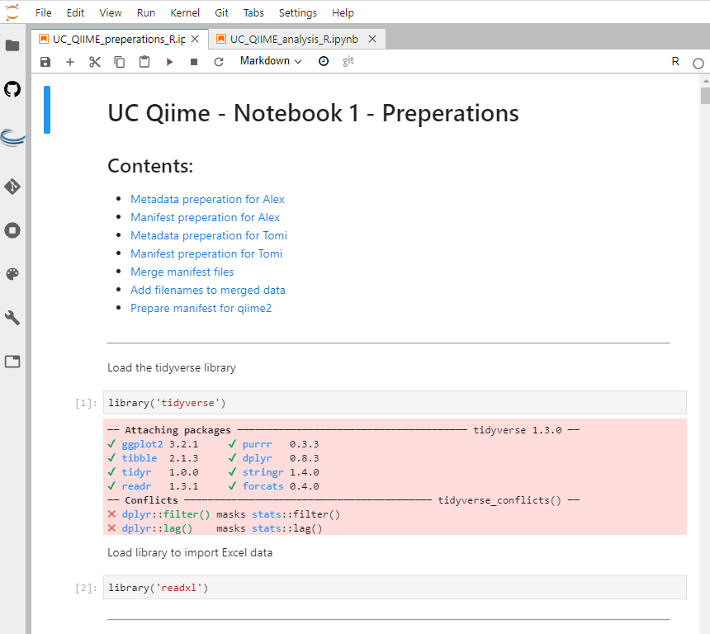
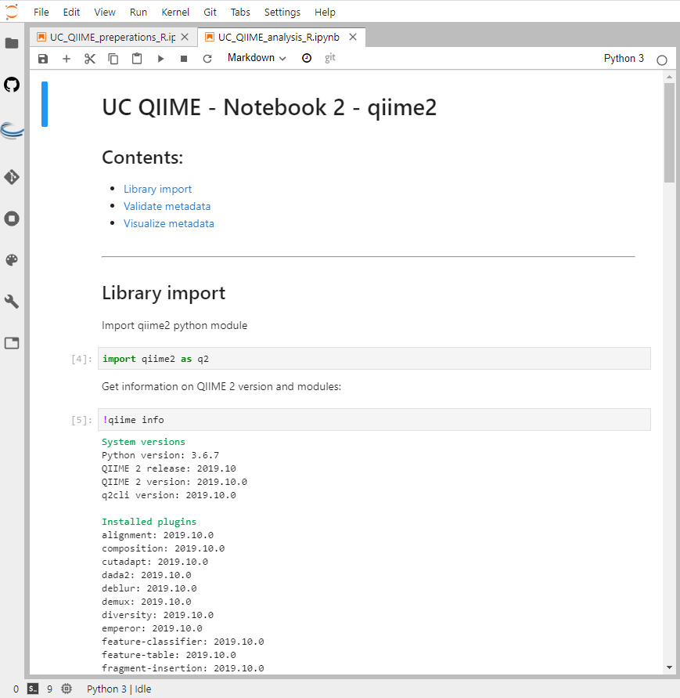
Implementation in Cyverse Austria
First software (Qiime2) had to be integrated in Cyverse Austria
use of Jupyter lab notebook (docker container)
Make input data compatible for import (metadata, manifest)
use of additional Jupyter lab notebooks
Final solution: two Jupyter lab notebooks

Slide 6
Remaining challenges
Integration of new tools
=> use of docker images
Integration of new containers (docker images)
Error interpretation (tool or Cyverse)
Nevertheless this pilot project shows the big potential to use tools inside of Jupyter lab notebooks in Cyverse Austria to follow the „FAIR“ principle and facilitate collaborations between different Universities.

