Slide 1
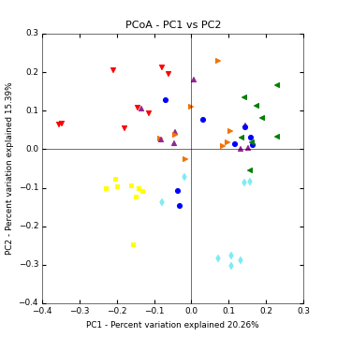
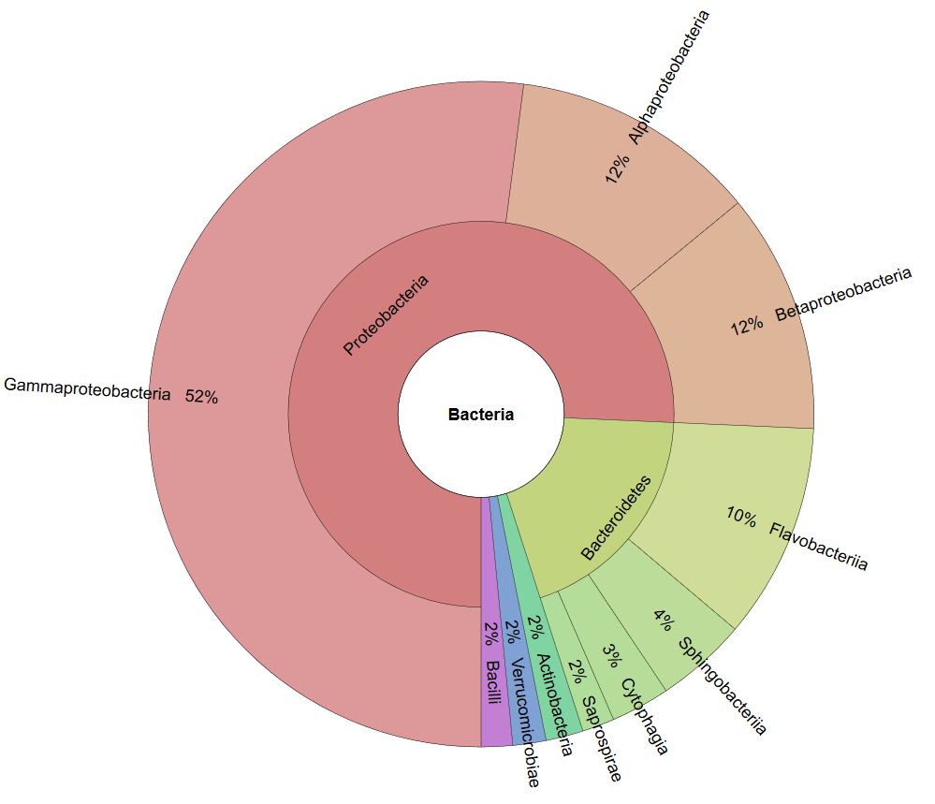
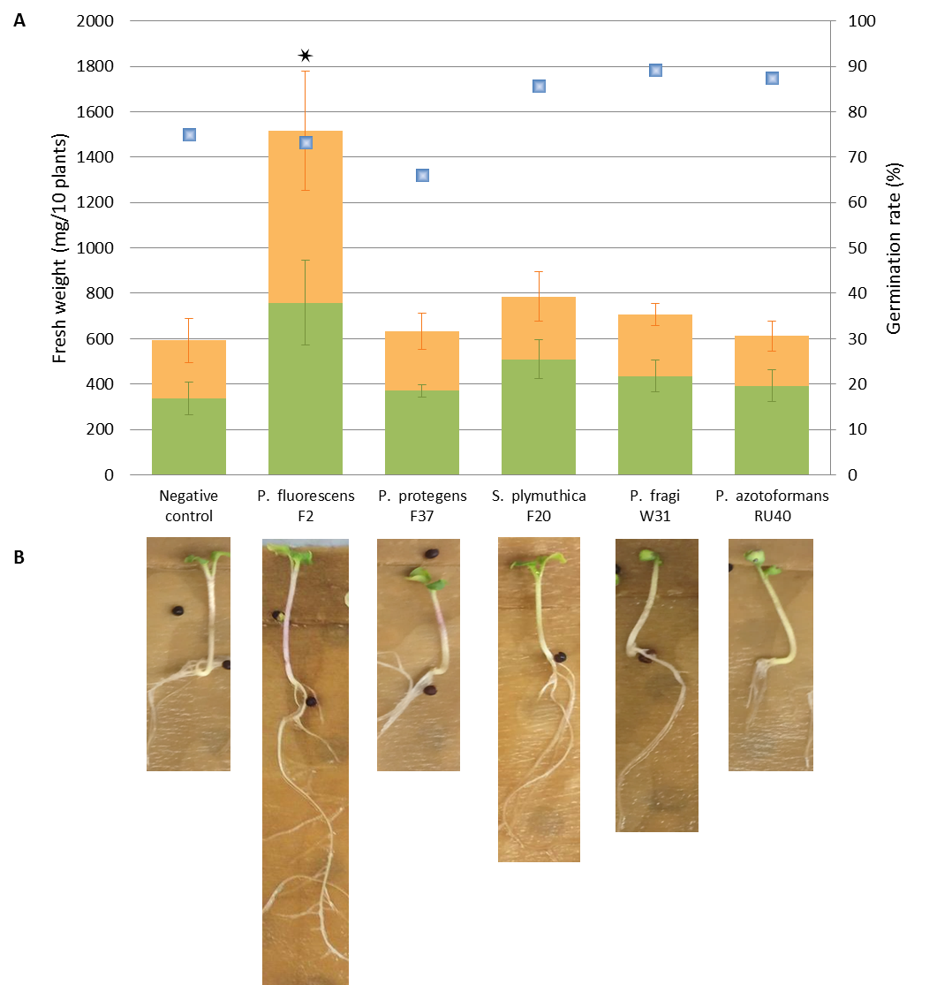
The microbiome of Brassicaceae :
plant protection and human health
Birgit Wassermann^{1,2}, Daria Rybakova¹, Gabriele Berg¹
¹ Institute of Environmental Biotechnology, Graz University of Technology, Austria
² Institute of Plant Sciences, University of Graz, Austria
In recent years, the microbiome has been identified as a key factor for plant health. Recently it was shown that the microbial community of edible plants contributes to the human microbiome. This study focuses on the microbiota of Brassica vegetables with potential benefits to human health and its possible application in crop protection. The glucosinolate-myrosinase system provides chemo-protective effects in humans, among others contributing to the anti-cancer qualities of the Brassicaceae. Plant myrosinase is however inactivated by storage and cooking, therefore it is of interest to identify vegetable-associated microbiota with myrosinase activity. The microbiome of the edible parts of seven different Brassica vegetables, each purchased at the farmer´s market and the supermarket, was examined by a multiphasic approach.
OBJECTIVES
Screening for myrosinase-active strains and myrosinase genes
Identification of bacterial strains with biocontrol potential
Bacterial community composition and the impact of the point of sale
THE EDIBLE MICROBIOME
The “edible core microbiome” of Brassica vegetables is dominated by Proteobacteria (76%) and Bacteriodetes (19%), based on 16S rRNA analysis. Microbial community composition is rather driven by the type of vegetable host than by the purchase source, with significant cultivar-specific influence of the purchase origin. Co-occurrence network analysis indicated rare taxa to be determining for a dense, interactive network.
MYROSINASE ACTIVE BACTERIA
Proteobacteria
Bacteriodetes
Verrucomicrobia
Actinobacteria
Armatimonadetes
Firmicutes
Deinococci
A high throughput screening of vegetable microbiomes combined with a GOD-POD coupled enzyme assay, HPLC, selective agar plates and a PCR with degenerate primers for a selective amplification of a myrosinase gene confirmed myrosinase activity for the isolated E. cloacae KS50. The putative myrosinase gene myrE was identified. Alignment of myrE against the metagenome of B. napus revealed higher incidence of the gene in the rhizosphere in comparison to the bulk soil.
Figure 1: Significant co-occurrence and co-exclusion relationships among the Brassica microbiome.
Figure 2: PCA shows bacterial community composition of seven Brassica cultivars: horseradish (red), rucola (yellow), radish (turquoise), white cabbage (blue), turnip cabbage (green), cauliflower (orange) and broccoli (purple).
Core microbiome
Figure 3: Core microbiome of Brassica vegetables
Bacterial community of Brassica vegetables
POTENTIAL BIOCONROL AGENTS
Plate assay
Degenerate primers
Five strain isolates from farmer´s market crops combat plant pathogen V. longisporum in vitro. P. fluorescens F2 revealed significant plant growth promoting (PGP) potential, as determined under gnotobiotic conditions in B. napus. Fluorescent in situ Hybridization (FISH) coupled with Confocal Laser Scanning Microscopy (CLSM) demonstrated the roots to be highly colonized by all antagonistic bacteria while seed borne strains predominated in phyllospheric parts.
Rhizosphere
P. fragi W31
Rhizosphere
P. fluorescens F2
Phyllosphere
P. fragi W31
HPLC
GOD-POD assay
Myrosinase active Brassica endophyte Enterobacter cloacae KS50
Figure 4: In situ colonization patterns visualized with CLSM. White arrows: antagonistic strains; red arrow: seed borne strains.
CONCLUSION
High bacterial diversity in Brassica crops with impact on plant and human health
Myrosinase active and PGP bacteria are natural inhabitants of Brassica vegetables
Myrosinase active E. cloacae might be an example for a long lasting relationship of plants and human gut
Brassica from farmer´s market harbor more Verticillium-antagonistic strains
The point of sale has significant cultivar-specific influence on the microbial community
Low abundant taxa seem to have strong impact on the microbial network construction
Figure 5: PGP effect of antagonistic strains. Green parts mean weight (green columns) and root mean weights (orange columns) of bio-primed B. napus seedlings in comparison to a negative control. The blue squares indicate germination rate in %.
Field trials with potential BCAs
Knock out mutants and characterization of the myrosinase protein
Are there more than one bacterial myrosinase genes?
Is myrosinase activity dependent on a co-metabolizing pathway?
REFERENCES
Berg, G., Erlacher, A., & Grube, M. (2015). The edible plant microbiome: importance and health issues. In Principles of Plant-Microbe Interactions (pp. 419-426). Springer International Publishing.
Rybakova, D., Schmuck, M., Wetzlinger, U., Varo-Suarez, A., Murgu, O., Müller, H., & Berg, G. (2015). Kill or cure? The interaction between endophytic Paenibacillus and Serratia strains and the host plant is shaped by plant growth conditions. Plant and Soil, 1-15.
Erlacher A, Cardinale M, Grosch R, Grube M, Berg G (2014) The impact of the pathogen Rhizoctonia solani and its beneficial counterpart Bacillus amyloliquefaciens on the indigenous lettuce microbiome. Frontiers in microbiology, 5
This project was funded by the European Union in frame of FP7-KBBE-2013-7-single-stage (BIOCOMES; No. 612713).
The authors gratefully acknowledge support from NAWI Graz.

