Slide 1
CSBME Internationalization Support Computer Science Academic Advising Sessions
Christian Gütl, Institute for Interactive Systems and Data Science
Version September 2023

Slide 2
Information about Academic Advising Team
Christian Gütl CSBME Coordinator for International Affairs
Contact
E-Mail: c.guetl@tugraz.at
Phone: +43 316 873 5604
Web: http://isds.tugraz.at/codis
Office: Room DH03-153, TU-Graz Sandgasse 36, 3rd Floor
Oral Consultation Hours
By appointment or email or Webex
Christian Gütl, Institute for Interactive Systems and Data Science

Slide 3
Information about Academic Advising Team
Contact Student Representation
E-Mail: iso@htugraz.at
Web: http://bits.htu.tugraz.at
Office: SZ02003, TU-Graz Inffeldgasse 10
Facebook Studienvertretung Informatik & Software Engineering TUGraz,
Instagram stv.iso_tugraz
Discord discord.gg/Vffepyb
Office hour(s) Mondays 17:00 – 18:00
Christian Gütl, Institute for Interactive Systems and Data Science

Slide 4
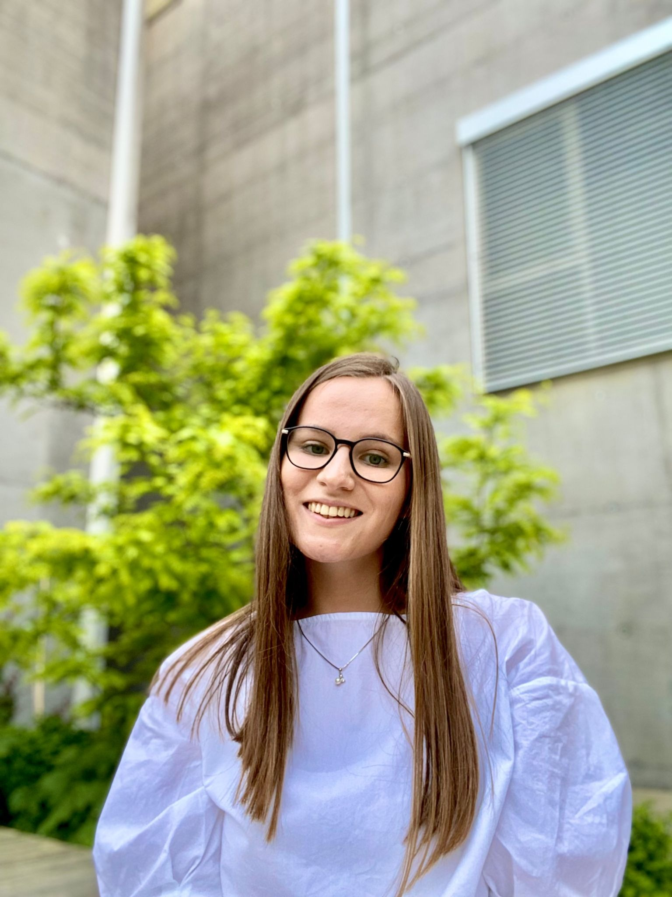
Information about Academic Advising Team
Peer Tutor for Incoming Students
Support for incoming students
Study program and organizational issues
Networking
Social Activities
Veljka Kocic
Join the WhatsApp Group!
Christian Gütl, Institute for Interactive Systems and Data Science

Slide 5
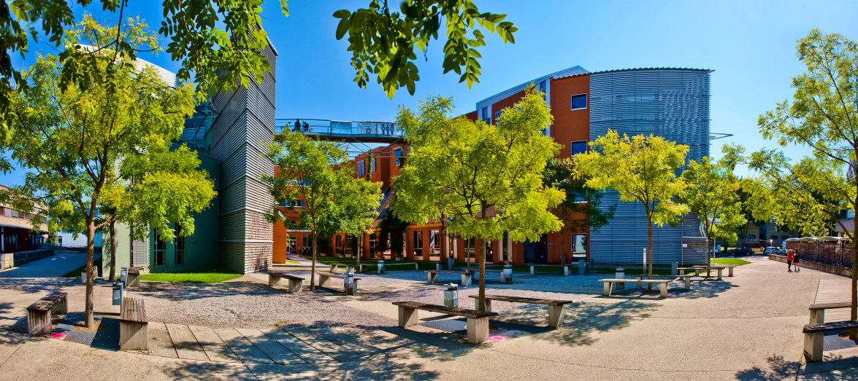
Overview of CSBME
Christian Gütl, Institute for Interactive Systems and Data Science

Slide 6
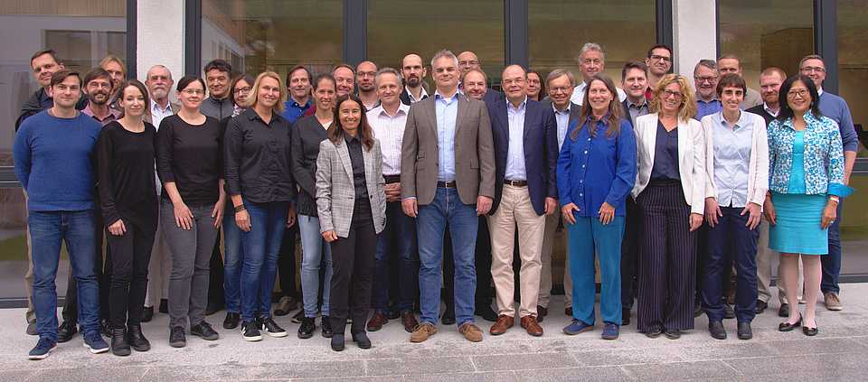
Computer Science & Biomedical Engineering
CSBME
Fasted growing faculty
11 institutes (schools)
45 professors (at any level) and 213 other scientists
Top 150 (World University Ranking)
CSBME Teaching
5 bachelors & 6 master
All master programs in English
Peer tutoring and support for international/incoming students
Student teams
Christian Gütl, Institute for Interactive Systems and Data Science

Slide 7
CS Programs
Computer Science
Software, Basics, Connection to Mathematics
Software Engineering and Management
Classical Engineering Program
Software, Business, Management, Information Systems
Information and Computer Engineering
Hardware und Software
Connection to Electrical Engineering
Computational Social Systems
CS Teacher Training Program
Christian Gütl, Institute for Interactive Systems and Data Science

Slide 8
Best Practices Studying CSBME Programs
Christian Gütl, Institute for Interactive Systems and Data Science

Slide 9
Learning at Technical Universities in Austria
The focus is on self-organized and self-regulated learning
Attendance (physical presence) is not obligatory for most lectures
Students organize their learning and managing the scheduling of the exams (several dates available)
Christian Gütl, Institute for Interactive Systems and Data Science

Slide 10
Types of Courses
Lectures (VO)
Exercises (UE)
Lectures with integrated exercises (VU)
Design exercises (KU)
Laboratory courses (LU)
Projects (PT)
Seminars (SE)
Seminar projects (SP)
Christian Gütl, Institute for Interactive Systems and Data Science

Slide 11
TU Graz Online System
Major source
Searching Courses
Information about pre-knowledge and skills
Enrollment of courses
Schedules and information about lecture rooms
Exam schedules and enrolment for exams
Christian Gütl, Institute for Interactive Systems and Data Science

Slide 12
At the Beginning of the Semester
Attend Introductory Lectures
Get to know the lectures
Overview of skills and how course is organized, also the exams
Sometimes exercises get organized in groups (annoying for course coordinator if you show up later to participate & formation of groups has passed)
Talk to the course coordinator in case you have special questions or requirements
Attend at least one full lecture
Get a better idea if selected course is in line with your interests and the pre-knowledge skills
Christian Gütl, Institute for Interactive Systems and Data Science

Slide 13
During the Semester
Plan your activities realistically
In particularly assignment and exercises can be time consuming!
Most of the time, no intermediate checks or checkpoints, and deadlines are hard deadlines!
In case you have questions or need help check with the course coordinator in time, also check with your peers
Christian Gütl, Institute for Interactive Systems and Data Science

Slide 14
Examinations
Enrolment of Exams
Plan carefully and enroll way ahead of time, number of places per exam can be limited
In case you want cancel the exam, manage to do in time (no show-ups annoy lecturers)!
Check with peers about information about exams (sometimes there are old exams for preparation available)
Start preparing in time!
Christian Gütl, Institute for Interactive Systems and Data Science

Slide 15
Useful Resources
Handbook “Studying at TU Graz”
https://www.tugraz.at/fileadmin/user_upload/tugrazInternal/Studium/Studieren_an_der_TU_Graz/StudienanfaengerInnen/Booklet_New_Students.pdf
Information for New Students
https://www.tugraz.at/en/studying-and-teaching/studying-at-tu-graz/information-for-new-students/
Website of CSBME
https://www.tugraz.at/fakultaeten/infbio/home/
Study Programs CSBME
https://online.tugraz.at/tug_online/pl/ui/$ctx/webnav.ini?pUrl=wborg.display%3FPORGNR=37
International Students at CSBME
https://www.tugraz.at/fakultaeten/csbme/studies/international-students/
Christian Gütl, Institute for Interactive Systems and Data Science

Slide 16
Concluding Remarks
We want to provide you a pleasant stay
Let us know issues but also positive experiences
Recommendations for improvement
Make use of Peer Tutoring for Incomings (!)
Learning Agreements
For changes, just send me an email (towards end of stay !)
Check with your coordinator at sending institution
Christian Gütl, Institute for Interactive Systems and Data Science

Slide 17
COVID-19 Related Information
Covid-19 Information for International Students
https://www.tugraz.at/en/studying-and-teaching/international-studying-and-teaching/internationals-at-tu-graz-covid-19-information/
Quarantine Support Service
https://www.tugraz.at/en/studying-and-teaching/international-studying-and-teaching/internationals-at-tu-graz-covid-19-information/#c322842
Christian Gütl, Institute for Interactive Systems and Data Science

Slide 18
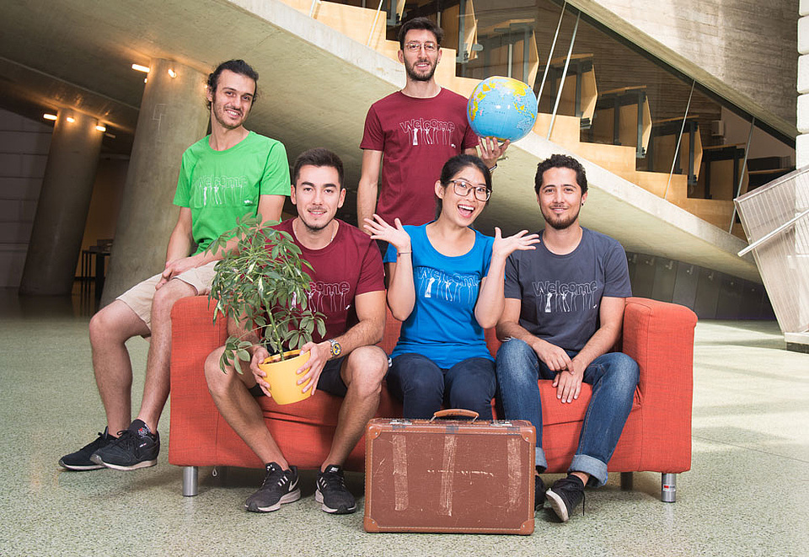
We wish you a pleasant stay!

